Slide 1
Citing Textual Evidence
Where’d you get that???

Slide 2
Standards
WHAT are we learning?
5.RL.KID.1 Quote accurately from a text when explaining what the text says explicitly and when drawing inferences from the text.
5.RL.KID.2 Determine a theme or central idea of a story, drama, or poem from details in the text; summarize the text.
5.RL.IKI.7 Explain how visual and multimedia elements contribute to the meaning, tone, or mood of a text…

Slide 3
Standards
WHY are we learning this?
You know how to convey, or state, what the text says explicitly – meaning, exactly what it says – but you should also be able to find the hidden meanings. When reading a text, you should make inferences based on observations...
Look for the ideas, themes, and values that authors embed within the text.
We should be able to state these themes in our own words and sometimes quote them directly.
Remember, texts are not just written words, but they can also be images (paintings, photographs, infographics, etc.).

Slide 4
Citing textual evidence
You’ve all cited textual evidence before…
Evidence-based writing is one of the most important literacy skills you need to acquire (learn).
Remember, when citing textual evidence, you need to answer two questions:
WHAT DOES YOUR SOURCE SAY?
WHY DOES THIS MATTER?
(SO WHAT?)
Notes:
TURN ATTENTION TO CITING TEXTUAL EVIDENCE CHART

Slide 5
Citing textual evidence
WHAT DOES YOUR SOURCE SAY?
WHY DOES THIS MATTER?
(SO WHAT?)
Your reader should never have to ask this question! You should explain why!
Explaining why a piece of evidence you’ve found matters is MORE important than giving the evidence in the first place.
Notes:
TURN ATTENTION TO CITING TEXTUAL EVIDENCE CHART

Slide 6
So What? Sentence Starters
(Why does this matter?)
This is a great example of…
The reader can see…
This shows...
The author outlines…
This proves…
That part of the text/ book…
This supports…
Authors do this to…
The purpose…
This helps…
This is important…
Reading this helped me to…
This represents…
Including this sentence…
The language here…
The author creates…
This can mean…
This might be the reason…
These words make me think…
This demonstrates...
This matters because…
CHOOSE 8 of these sentence starters.
Record them in the table on your notes.

Slide 7
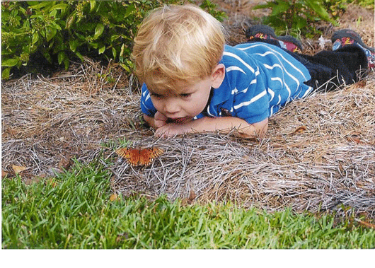
Child in Wonder
Does knowing the title of the photograph cause you to revise your thoughts at all?
Take 3 minutes to write what you know about this photograph.
GUIDING QUESTIONS
What is the relationship
between the characters
in this image?
What’s happening? Is there a narrative/story?
*Remember to use So what? sentences to explain your thinking!
Notes:
Reading Images example: Take a few minutes to write what you know/think about this picture.
Whatever you think, you have to EXPLAIN IT. Incentivize giving evidence (LiveSchool Points)

Slide 8
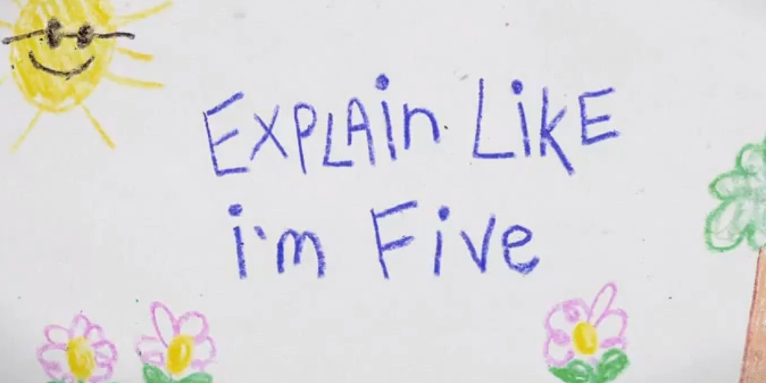
Partner share
Take a few minutes to share your writing with a partner.
During your discussion, check each other’s So What? sentences. Did your partner explain their thinking clearly? If not, what could they add that would help you understand their thought process? Add sentences if necessary!
Remember, it’s not enough just to say what you’re thinking. EXPLAIN WHY!!!

Slide 9
How will we apply this to writing???
WHAT have we learned?
5.RL.KID.1 Quote accurately from a text when explaining what the text says explicitly and when drawing inferences from the text.
5.RL.KID.2 Determine a theme or central idea of a story, drama, or poem from details in the text; summarize the text.
5.RL.IKI.7 Explain how visual and multimedia elements contribute to the meaning, tone, or mood of a text…
REMEMBER TO USE THE “SO WHAT?” APPROACH… ANY TIME YOU ARE WRITING, EXPLAIN YOUR THINKING!
When answering questions or making inferences about a text, be sure to state WHAT you know and HOW or WHY you know it!

Slide 10
Citing text evidence Wonder
Directions: After reading the excerpt from the novel Wonder, answer the question by citing text evidence. Then, explain your thinking using a “So What?” sentence.
Example: August thought, “I could tell Henry did not want to move next to me, just by the way he dragged his backpack on the floor as he came over, like he was moving in slow motion.” (p.39) This is important because it shows that August is an outcast at school.

Slide 11
Teammate Practice
Excerpt: from “Lamb to the Slaughter” (p.43)
“Like a lamb to the slaughter”: Something that you say about someone who goes somewhere calmly, not knowing that something unpleasant is going to happen to them.
I Googled it last night. That’s what I was thinking when Ms. Petosa called my name and suddenly it was my turn to talk.
“My name is August,” I said, and yeah, I kind of mumbled it.
“What?” said someone.
“Can you speak up, honey?” said Ms. Petosa.
“My name is August,” I said louder, forcing myself to look up. “I, um ... have a sister named Via and a dog named Daisy. And, um … that’s it.”
Question: How does the author foreshadow that August is about to have a bad experience?

Slide 12
Exemplary Responses
Excerpt: from “Lamb to the Slaughter” (p.43)
“Like a lamb to the slaughter”: Something that you say about someone who goes somewhere calmly, not knowing that something unpleasant is going to happen to them.
I Googled it last night. That’s what I was thinking when Ms. Petosa called my name and suddenly it was my turn to talk.
“My name is August,” I said, and yeah, I kind of mumbled it.
“What?” said someone.
“Can you speak up, honey?” said Ms. Petosa.
“My name is August,” I said louder, forcing myself to look up. “I, um ... have a sister named Via and a dog named Daisy. And, um … that’s it.”
Question: How does the author foreshadow that August is about to have a bad experience?
(1) August Googled the phrase “Like a lamb to the slaughter” and found out that it is used to describe “that something unpleasant is going to happen” (p.43). By including details about this idiom in the text, the author foreshadows that August will have a bad experience at school.
(2) The author foreshadows that August will have a bad experience because he Googled the phrase “Like a lamb to the slaughter” after hearing his parents’ conversation (p.43). The language here makes the reader think that something bad will happen to August at school.

Slide 13
Independent Practice
Reread: “Lunch” (pp.49-50)
Question: August becomes very self-conscious in the lunchroom. Cite and explain why.

Slide 14
Exemplary Response
Reread: “Lunch” (pp.49-50)
Question: August becomes very self-conscious in the lunchroom. Cite and explain why.
August becomes self-conscious in the lunchroom when he notices other students staring at him. Specifically, he says, “I hate the way I eat. I know how weird it looks” (p.50). The author outlines the reason that August says this when he explains further, “I eat like a tortoise, if you’ve ever seen a tortoise eating. Like some prehistoric swamp thing.” This shows that he is really nervous about being watched while he eats lunch at school.

