Slide 1
Citing Textual Evidence
Where’d you get that???

Slide 2
Standards
WHAT are we learning?
5.RL.KID.1 Quote accurately from a text when explaining what the text says explicitly and when drawing inferences from the text.
5.RL.KID.2 Determine a theme or central idea of a story, drama, or poem from details in the text; summarize the text.
5.RL.IKI.7 Explain how visual and multimedia elements contribute to the meaning, tone, or mood of a text…

Slide 3
Standards
WHY are we learning this?
You know how to convey, or state, what the text says explicitly – meaning, exactly what it says – but you should also be able to find the hidden meanings. When reading a text, you should make inferences based on observations...
Look for the ideas, themes, and values that authors embed within the text.
We should be able to state these themes in our own words and sometimes quote them directly.
Remember, texts are not just written words, but they can also be images (paintings, photographs, infographics, etc.).

Slide 4
Citing textual evidence
You’ve all cited textual evidence before…
Evidence-based writing is one of the most important literacy skills you need to acquire (learn).
Remember, when citing textual evidence, you need to answer two questions:
WHAT DOES YOUR SOURCE SAY?
WHY DOES THIS MATTER?
(SO WHAT?)
Notes:
TURN ATTENTION TO CITING TEXTUAL EVIDENCE CHART

Slide 5
Citing textual evidence
WHAT DOES YOUR SOURCE SAY?
WHY DOES THIS MATTER?
(SO WHAT?)
Your reader should never have to ask this question! You should explain why!
Explaining why a piece of evidence you’ve found matters is MORE important than giving the evidence in the first place.
Notes:
TURN ATTENTION TO CITING TEXTUAL EVIDENCE CHART

Slide 6
So What? Sentence Starters
(Why does this matter?)
This is a great example of…
The reader can see…
This shows...
The author outlines…
This proves…
That part of the text/ book…
This supports…
Authors do this to…
The purpose…
This helps…
This is important…
Reading this helped me to…
This represents…
Including this sentence…
The language here…
The author creates…
This can mean…
This might be the reason…
These words make me think…
This demonstrates...
This matters because…
CHOOSE 8 of these sentence starters.
Record them in the table on your notes.
Notes:
Choose 5 of these sentence starters to record at the top of your page…
Then, go ahead and sketch out possibilities for your own chart. I’ll set a timer to give you time to discuss and absorb.

Slide 7
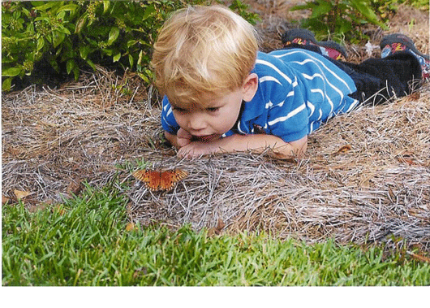
Child in Wonder
Does knowing the title of the photograph cause you to revise your thoughts at all?
Take 3 minutes to write what you know about this photograph.
GUIDING QUESTIONS
What is the relationship
between the characters
in this image?
What’s happening? Is there a narrative/story?
*Remember to use So what? sentences to explain your thinking!
Notes:
Reading Images example: Take a few minutes to write what you know/think about this picture.
Whatever you think, you have to EXPLAIN IT. Incentivize giving evidence (LiveSchool Points)

Slide 8
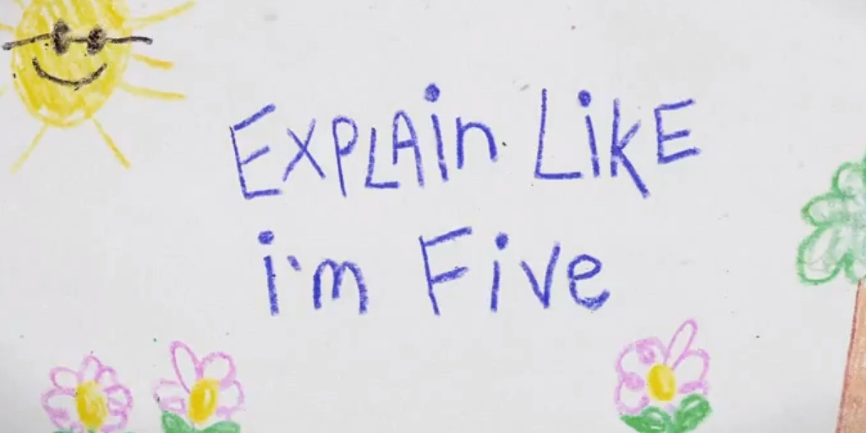
Partner share
Take a few minutes to share your writing with a partner.
During your discussion, check each other’s So What? sentences. Did your partner explain their thinking clearly? If not, what could they add that would help you understand their thought process? Add sentences if necessary!
Remember, it’s not enough just to say what you’re thinking. EXPLAIN WHY!!!

Slide 9
How will we apply this to writing???
WHAT have we learned?
5.RL.KID.1 Quote accurately from a text when explaining what the text says explicitly and when drawing inferences from the text.
5.RL.KID.2 Determine a theme or central idea of a story, drama, or poem from details in the text; summarize the text.
5.RL.IKI.7 Explain how visual and multimedia elements contribute to the meaning, tone, or mood of a text…
REMEMBER TO USE THE “SO WHAT?” APPROACH… ANY TIME YOU ARE WRITING, EXPLAIN YOUR THINKING!
When answering questions or making inferences about a text, be sure to state WHAT you know and HOW or WHY you know it!

Slide 10
Citing text evidence Wonder
Directions: After reading the excerpt from the novel Wonder, answer the question by citing text evidence. Then, explain your thinking using a “So What?” sentence.
Example: August states, “I was pretty sure I would never go back to school again.” (p.80) This is important because it shows how upset he was by the conversation he overheard between Jack and Julian.

Slide 11
Teammate Practice
Excerpt: from “Why I Changed My Mind” (p.139)
“Who else did Mr. Tushman call?” I asked Mom later that night. “Did he tell you?”
“He mentioned Julian and Charlotte.”
“Julian!” I said. “Ugh. Why Julian?”
“You used to be friends with Julian!”
“Mom, that was like in kindergarten. Julian’s the biggest phony there is. And he’s trying so hard to be popular all the time.”
“Well,” said Mom, “at least Julian agreed to help this kid out. Got to give him credit for that.”
I didn’t say anything because she was right.
Question: Why does Jack change his mind about going to meet August?

Slide 12
Exemplary Responses
Excerpt: from “Why I Changed My Mind” (p.139)
“Who else did Mr. Tushman call?” I asked Mom later that night. “Did he tell you?”
“He mentioned Julian and Charlotte.”
“Julian!” I said. “Ugh. Why Julian?”
“You used to be friends with Julian!”
“Mom, that was like in kindergarten. Julian’s the biggest phony there is. And he’s trying so hard to be popular all the time.”
“Well,” said Mom, “at least Julian agreed to help this kid out. Got to give him credit for that.”
I didn’t say anything because she was right.
Question: Why does Jack change his mind about going to meet August?
(1) Jack thinks to himself, “I didn’t say anything because she was right.” (p.139) This shows that he agrees with his mom; meeting August and helping him out is the right thing to do.
(2) Jack says, “Ugh. Why Julian…(he’s) the biggest phony there is.” (p.139) This reveals to the reader that Jack probably knows that Julian is not a very nice person, so Jack decides it would be best to help August.

Slide 13
Independent Practice
Reread: “Four Things” (pp.142-143)
Question: Jack decides that he really likes August. Cite and explain two reasons why.

Slide 14
Exemplary Response
Reread: “Four Things” (pp.142-143)
Question: Jack decides that he really likes August. Cite and explain two reasons why.
Jack decides that he really likes August. He shows this when he says, “he’s actually a really cool dude. I mean, he’s pretty funny.” (p.142) These words make me think that Jack really appreciates August’s sense of humor and enjoys hanging out with him. Jack also states, “if all the guys in the fifth grade were lined up against a wall and I got to choose anyone I wanted to hang out with, I would choose August.” (p.143) R.J. Palacio includes this detail to prove that Jack really thinks of August as his best friend.

