Slide 1
Bell Ringer Writing Prompt
Writing Prompt (choose ONE option):
1) Why is it important to know the dates of events in history?
OR
2) Why must scientists follow steps in order to complete an experiment?
Explain how this relates to the sequence of events in a narrative.

Slide 2
Order & Sequence
(Chronological)
Text Structure
Nonfiction Text Structures

Slide 3
What are we learning?
CCRA.R.5 Analyze the structure of texts, including how specific sentences, paragraphs, and larger portions of the text (e.g., a section, chapter, scene, or stanza) relate to each other and the whole.
CCRA.W.2 Write informative/explanatory texts to examine and convey complex ideas and information clearly and accurately through the effective selection, organization, and analysis of content.

Slide 4
Why are we learning this?
Analyzing text structure helps readers to comprehend what they read.
Understanding text structure makes you a better writer because you can organize your own ideas in ways that maximize reader comprehension.

Slide 5
Order and Sequence (Chronological Order)
Definition: the author provides readers with chronological events or a list of steps in a procedure
Clues: events in order of occurrence, instructions given step-by-step, time order words: first, next, then, afterward, last…
Visual:

Slide 6
ORDER & SEQUENCE Text Structure
Interactive Notebook Entry
Follow these steps to create your entry:
Add “Order & Sequence Text Structure” to your Table of Contents.
Read the short paragraph.
Color code each sequential event using a different color. Then, outline each box using those colors in the same order.
Fill in each box in order by summarizing the sentences you underlined. Be sure that they are in order and that each color
matches the box!
What evidence indicates that this text uses Order & Sequence text structure?

Slide 7
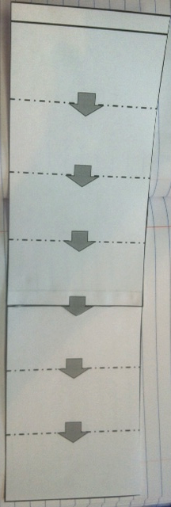
ORDER & SEQUENCE Text Structure
Interactive Notebook Entry
Cut out each half of the template.
Match and glue the ends together
so that it looks like the photos.

Slide 8
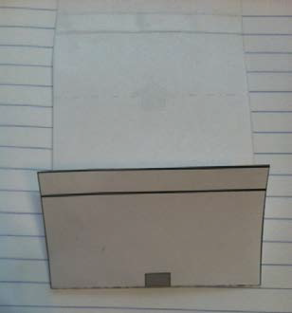
ORDER & SEQUENCE Text Structure
Interactive Notebook Entry
Fold the graphic organizer accordion (fan) style. The first fold is shown below.
(You are folding the
long strip back and
forth on each line.)

Slide 9
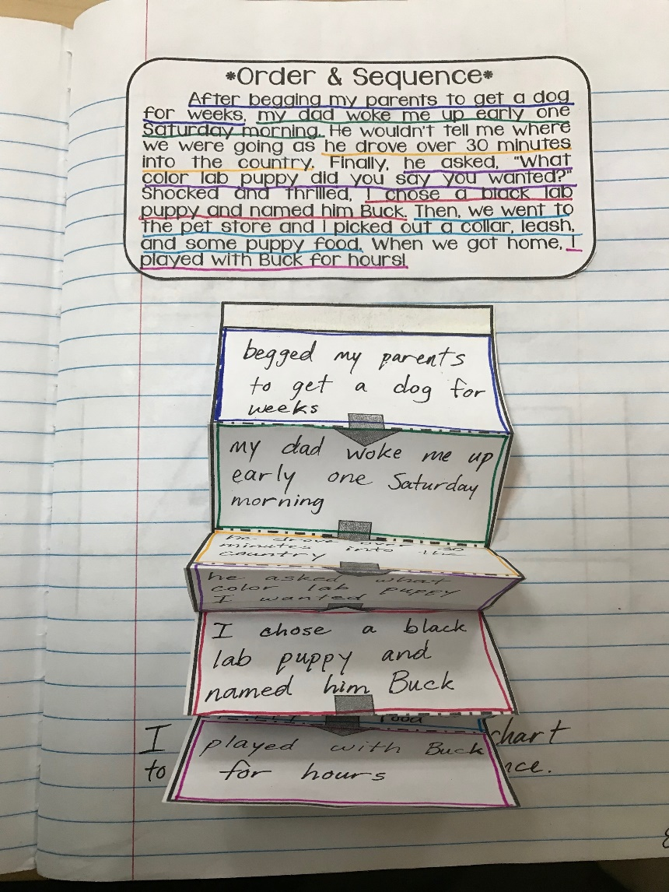
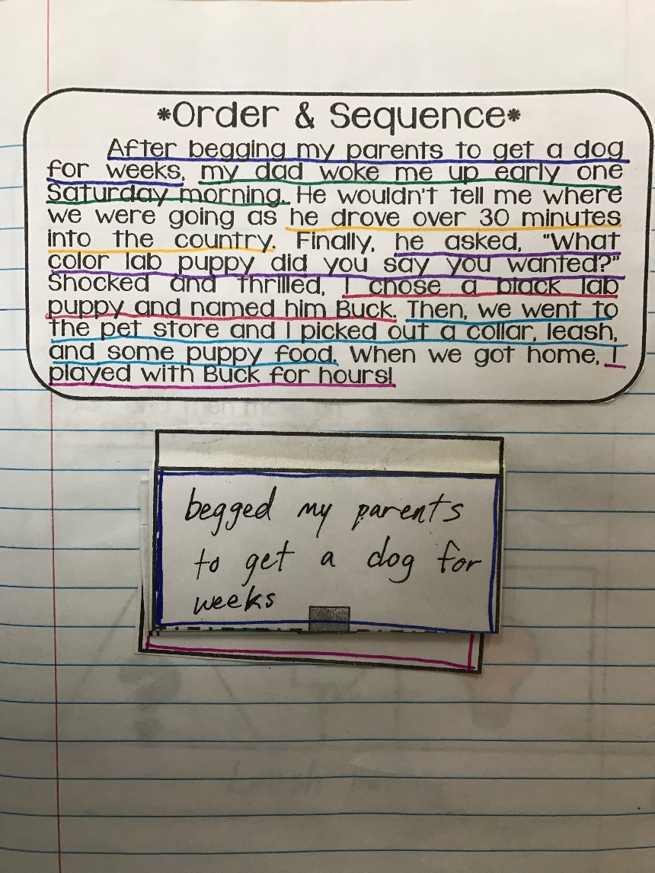
ORDER & SEQUENCE Text Structure
Interactive Notebook Entry
Glue down the top tab and tuck the graphic
organizer under itself so the it looks like the
photos.

