Slide 1
The Oklahoma Land Rush
English Language Arts Unit

Slide 2
Learning Standards
5.RI.KID.2 Determine the main idea of a text and explain how it is supported by key details; summarize the text.
5.RI.KID.3 Explain the relationships and interactions among two or more individuals, events, and/or ideas in a text.
5.RI.CS.4 Determine the meaning of words and phrases as they are used in a text relevant to a grade 5 topic or subject area, including figurative, connotative, and technical meanings.

Slide 3
I can statements…
I can identify how obstacles are overcome to achieve goals.
I can think of different solutions for problems and think of the consequences.

Slide 4
Driving Question
Why do people make certain choices?

Slide 5
Summative Writing Task
Based on what you know about the Oklahoma Land Rush of 1889, write a letter to people who are about to participate in the land rush of 1891 to help them be successful in their quest for land. Provide the potential settlers with at least two pieces of advice and explain how each piece of advice will help them overcome challenges that come with participating in a land rush. Make sure that your advice is based in evidence from both unit texts.

Slide 6
Text #1: “Built in a Day: The Oklahoma Land Rush” by the National Park Service
We will begin by annotating the text, using symbols from our Annotation Chart. Follow along, make annotations, and identify unknown vocabulary as we read together.

Slide 7
Text #1: “Built in a Day: The Oklahoma Land Rush” by the National Park Service
This text includes both primary and secondary sources.
What’s the difference?
Which is more reliable?

Slide 8
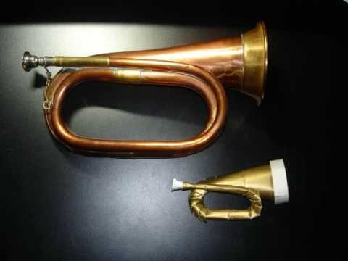
Text #1: “Built in a Day: The Oklahoma Land Rush” by the National Park Service
“reveille” – line 72

Slide 9
Text #1: “Built in a Day: The Oklahoma Land Rush” by the National Park Service
Comprehension Questions:
What do you learn about the Homestead Act and the Oklahoma Land Rush from reading this text?
What places in the text are getting in your way of understanding?

Slide 10
Text #1: “Built in a Day: The Oklahoma Land Rush” by the National Park Service
Analysis Question:
What does the author do to give you a clear picture of the Oklahoma Land Rush of 1889 and the people involved?

Slide 11
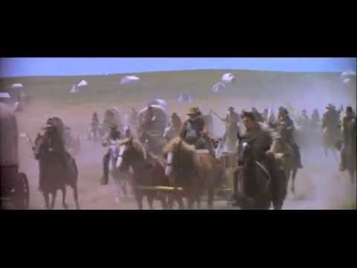
Text #1: “Built in a Day: The Oklahoma Land Rush” by the National Park Service
The Oklahoma Land Rush
Scene from “Far and Away” (1992)

Slide 12
Text #1: “Built in a Day: The Oklahoma Land Rush” by the National Park Service
Interpretation:
Given what you’ve learned from your readings, writings, and discussion, what adjective best describes the people who were involved in the Oklahoma Land Rush of 1889? Write an explanation of your chosen adjective by drawing on evidence from across the text.

Slide 13
Text #1: “Built in a Day: The Oklahoma Land Rush” by the National Park Service
Identify Challenges:
Now that you’ve read and annotated the text, turn to p.8 in your Student Reader. List the challenges faced by settlers and Indians that you identified while reading. You may list them as bullet points.

Slide 14
Text #2: “The Rush to Oklahoma” by William Willard Howard
Working with a partner, read and annotate the text, using symbols from our Annotation Chart. Focus on interpreting unknown vocabulary and identifying main ideas and key details.

Slide 15
Text #2: “The Rush to Oklahoma” by William Willard Howard
Working with a partner, read and annotate the text, using symbols from our Annotation Chart. Focus on interpreting unknown vocabulary and identifying main ideas and key details.

Slide 16
Text #2: “The Rush to Oklahoma” by William Willard Howard
Bell Ringer: (Answer on p.10.)
What do you learn about the Oklahoma Land Rush of 1889 from reading Howard’s text?
What places in the text are getting in your way of understanding?

Slide 17
Text #2: “The Rush to Oklahoma” by William Willard Howard
Identify Challenges:
Now that you’ve read and annotated the text, turn to p.10 in your Student Reader. List the challenges faced by homesteaders that you identified while reading. You may list them as bullet points.

Slide 18
Text #1 “Built in a Day: The Oklahoma Land Rush” and Text #2: “The Rush to Oklahoma”
Discussion Questions:
What are the biggest differences in the content of the two texts?
Which text gives you a better sense of what it must have been like to be involved in the land rush? Why?

Slide 19
Writing Task – Graphic Organizer Record this table on page 18 in your Student Reader. You will take notes in the table for your prewriting.
Challenge | Advice | Explanation

Slide 20
Summative Writing Task
Based on what you know about the Oklahoma Land Rush of 1889, write a letter to people who are about to participate in the land rush of 1891 to help them be successful in their quest for land. Provide the potential settlers with at least two pieces of advice and explain how each piece of advice will help them overcome challenges that come with participating in a land rush. Make sure that your advice is based in evidence from both unit texts.

