Slide 1
Figurative Language
5th grade Literacy

Slide 2
{Agenda}
Boardwork sheet: Descriptive words
TEAM Practice: Note-taking
Teammate Practice: “Walk around the room” activity
Independent Practice: Video
Exit ticket

Slide 3
{Objectives}
I CAN...
define each type of figurative language
identify examples of figurative language

Slide 4
{Goal Setting}
Set a goal for today’s lesson
Your goal should be...
Specific
Reasonable
Relate to today’s lesson

Slide 5
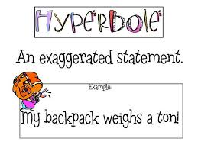
{Hyperbole}
Definition: an exaggeration that cannot possibly be true
Example:
I was eaten alive by the mosquitos
Cried a million tears

Slide 6
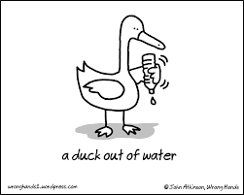
{Metaphor}
Definition: Comparison of two unlike things without “like or as”
Example: The clouds were shadows

Slide 7
{Simile}
Definition: comparison of two unlike things that uses like or as
Example: Like a lamb to the slaughter

Slide 8
{Personification}
Definition: an animal, idea, or thing is given human qualities
Example: Nature will be kind to you

Slide 9
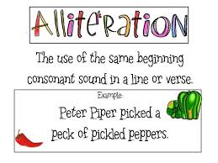
{Alliteration}
Definition: repeating sounds at the beginning of words
Example: Sally sells sea shells by the seashore

Slide 10
{Repetition}
Definition: repeats the same word or phrase multiple times
Example: Mary had a little lamb, a little lamb...

Slide 11
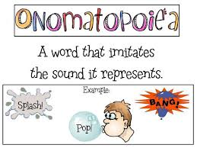
{Onomatopoeia}
Definition: word that imitates the sound it represents
Example: SPLAT!!

Slide 12
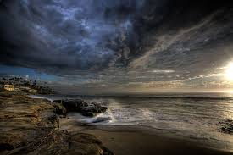
{Imagery}
Definition: using vivid or descriptive words
Example: I heard the delightful melodies of the many birds.

Slide 13
{Idiom}
Definition: a phrase whose literal meaning is different from its implied meaning
Example:
Out of the loop
A good egg

Slide 14
{Stop & Jot Reflection Questions}
What is the purpose of using figurative language in your writing? How can it enhance your writing?
How will your understanding of figurative language be helpful while you’re reading?
**Make sure your responses are written in complete sentences & that you re-state the question.**

Slide 15
{Teammate Practice}
Activity: Walk Around the Room
[Directions]:
There are 9 different posters around the room.
Read the task card on each poster & complete the activity.
**Record your answer on a post-it note and place that on the poster. Make sure that you put your name(s) on the post-it note, too.**
[Above & Beyond]: Extend each task card by creating an additional example or explaining what it means, etc.

Slide 16
{Independent Practice}
[Directions]:
Watch the video
Record your responses to the “stop & jot” questions on the recording sheet
[Above & Beyond]: try to record all of the examples for each type of figurative language ☺

Slide 17
{Exit Ticket}
[Directions]:
Grab a post-it note. Write your name on the top of it.
Answer the following questions
Question #1: On a scale of 1-10 (10 being the most confident), how do you feel about your ability to define each type of figurative language?
Question #2: On a scale of 1-10 (10 being the most confident), how do you feel about your ability to identify types of figurative language?
Question #3: What is something that you can do and/or something that I can help you with to further your understanding of figurative language?
[Above & Beyond]: on a sheet of paper, write a story using the different types of figurative language that we discussed today ☺
**Place your post-it note on your assigned number when you are dismissed.**

