Slide 1
Explanations
5th grade Literacy

Slide 2
Explanations
An explanation tells your reader how the evidence connects to the topic sentence of the paragraph.
An explanation sentence should answer two questions:
What does the evidence mean?
Why does it matter?

Slide 3
Explanations
Before your write an explanation:
Re-read your topic sentence.
Re-read your evidence.

Slide 4
Writing an Explanation
Step 1: Use a transition word for explaining.
This means,
In other words,
Basically
This shows that
Step 2: Explain what your evidence means and how it supports the topic sentence in your own words.

Slide 5
Exemplary Explanations
How does the explanation connect the evidence to the topic sentence?

Slide 6
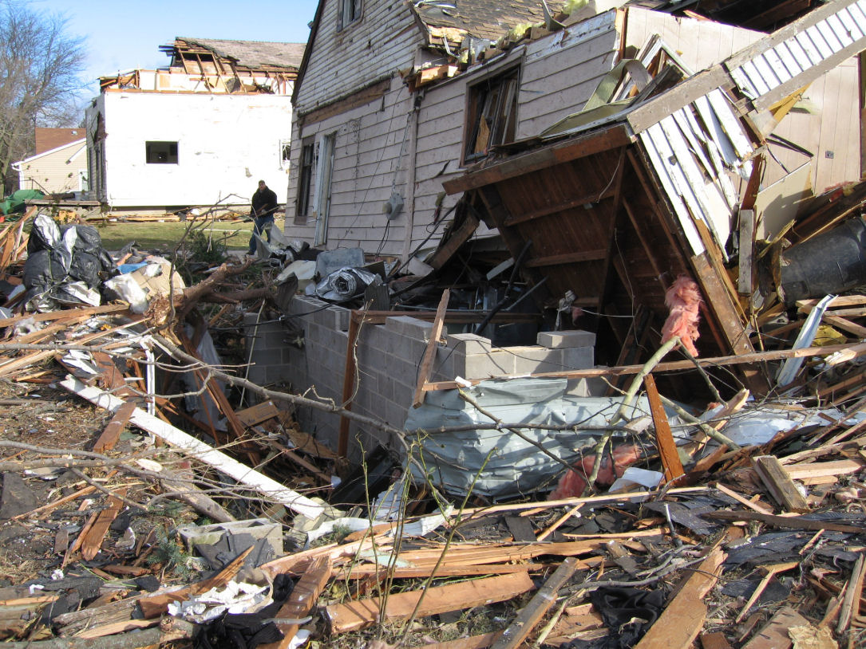
Team Practice

Slide 7
Teammate Practice

