Slide 1
Evidence and Paraphrasing
5th grade Literacy

Slide 2
Evidence
Evidence is information taken from a text or personal example that supports the topic of your paragraph.
Each supporting detail should have one piece of evidence.

Slide 3
Can Someone Steal Music?
Notes:
Stop playing video at 1:50

Slide 4
Video Annotations
1. How many different bands are featured in this video?
2. What are some similarities you notice between the songs?
3. What are some differences between the songs?

Slide 5
Think-Pair-Share
1. In your opinion, did the musicians in this video do anything wrong? Why or why not?
2. How do these different songs relate to our work in the Literacy classroom and writing?

Slide 6
What is plagiarism?
The video we just watched is an example of plagiarism.
The word plagiarism comes from the latin-word plagiarius, which means kidnapper.
In our time, plagiarism means to present someone else’s ideas as your own.

Slide 7
Examples of Plagiarism
Copied words into your paper from an article without quotation marks or without citing the source.
Talking about someone else’s invention, and pretending that it is your own.
Write your own example!

Slide 8
Stop & Jot
Which part of our paragraph do we need to be the most careful that we are not plagiarizing? Why?

Slide 9
Paraphrasing
Re-stating what the author has said in your own words is called paraphrasing.
Paraphrasing is very useful when we are giving evidence.

Slide 10
Times When We Will Paraphrase
There are many times when we want to paraphrase to give evidence:
When we want to explain an idea or argument that the author has.
When we want to summarize several sentences.
Making a list of ideas that the author gives throughout a paragraph.

Slide 11
How to Paraphrase
How to Paraphrase:
Read the direct quotation, annotate it to make sure that you know what it means.
Write it in your own words.
Transition
Name of the source
What you think it means.

Slide 12
Some Other Rules
Never change names, places, or facts.
Do not make up new information.

Slide 13
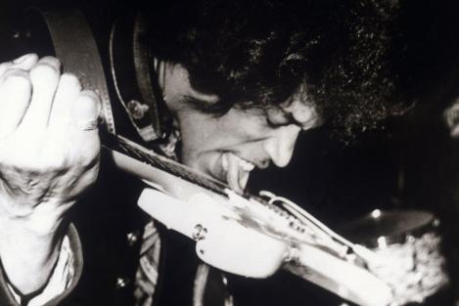
Example
Direct Quotation
“Many people believe that Jimmy Hendrix is the greatest guitar player that ever existed because he could play with his teeth!” -Rolling Stone Magazine
Paraphrase
For example, Rolling Stone Magazine reported that Jimmy Hendrix became so popular because of the strange ways he could play the guitar.

