Slide 1
How to A.C.E. text-dependent questions

Slide 2
Learning standards
5.RL.KID.1 Quote accurately from a text when explaining what the text says explicitly and when drawing inferences from the text.
5.W.PDW.4 Produce clear and coherent writing in which the development, organization, and style are appropriate to task, purpose, and audience.

Slide 3
I can…
I can quote accurately from a text to answer text-dependent questions using the A.C.E. method!
Write this I can statement on the top line of this page in your interactive notebook.

Slide 4
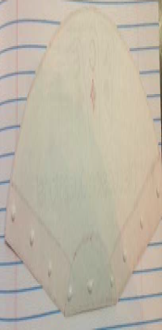
Step one – ready the I.R.N.
Cut out the A.C.E. Fan and the individual A.C.E. cards.
Place baby dots of glue or use glue stick around ONLY the outer edges of the fan.

Slide 5
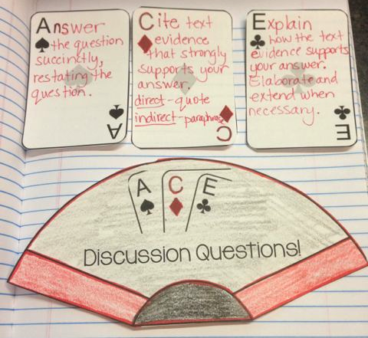
Step one – ready the I.R.N.
Place fan in the interactive notebook at the bottom of the page (leave plenty of room to write several sentences above the fan!).
Record the notes on the next slide on each individual A.C.E. card.

Slide 6
Card notes
Answer the question succinctly, restating the question.
Cite text evidence that strongly supports your answer. direct – quote indirect – paraphrase
Explain how the text evidence supports your answer. Elaborate and extend when necessary.

Slide 7
Shared reading: Names
As we read the chapter Names (pp.79-80) in Wonder, consider the following question:
What emotion(s) is August feeling during the chapter Names? Cite text evidence to support your answer.
Before we begin reading, write this question on the line below the I can statement.

Slide 8
Character traits
Feelings are an example of “character traits” – unique attributes that real-life people and characters in narratives often display.
Let’s take a look at some examples of character traits before reading. Think about which of these August displays in the chapter Names.
Notes:
Click link to see examples from readwritethink.org

Slide 9
Reflection
After reading Names, discuss the question in your table groups:
What emotion(s) is August feeling during the chapter Names? Cite text evidence to support your answer.

Slide 10
A.C.E. Method
A.C.E. the question by following the steps:
Answer: Write A: and record your answer in a complete sentence. Use this format.
August is feeling _______ in the chapter Names. (Notice how we restated the question?!?)
Cite: Write C: and list the text evidence.
On page ____, the author writes, “__________ .”
Explain: Write E: and explain why this matters. This proves that August is feeling _______ because ___________________.
Notes:
Students will record this below the question in their interactive notebook.

