Slide 1
Writing Sentences
A guide to writing good, better, and best sentences

Slide 2
Learning Standard
5.FL.SC.6 Demonstrate command of the conventions
of standard English grammar and usage… when writing.

Slide 3
Essential Questions
How do writers craft good sentences?
How can writers vary their sentences to make their writing more interesting?

Slide 4
Good Sentences
Purpose: Build simple sentences with the same pattern:
Describer + Subject + Vivid Verb
(adjective) (noun) (action verb)
This basic sentence pattern will help you create “Good Sentences.”

Slide 5
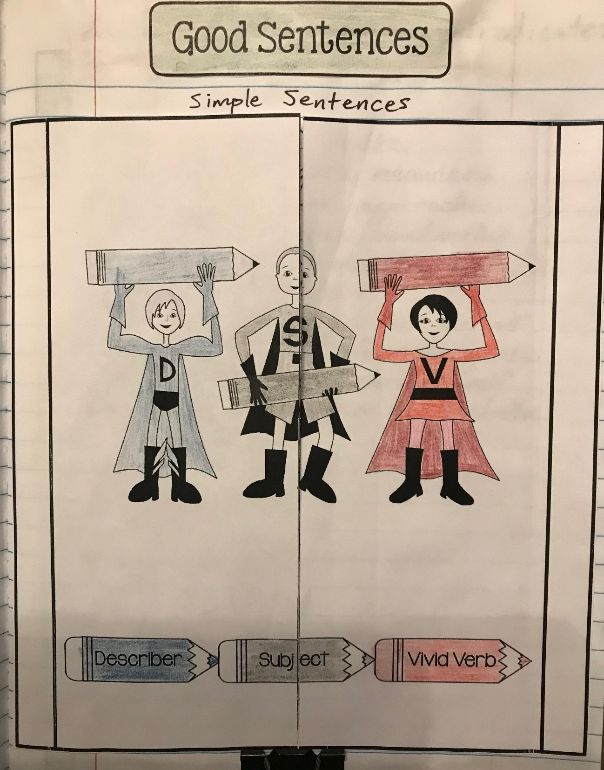
Good Sentences
Follow these steps to create the interactive notebook entry:
Color code the superheroes and pencils.
Cut the entire template around the perimeter.
Place glue along the backs of both side tabs.
Glue it down in one piece. (DO NOT cut the center line yet!) After 1-2 minutes, snip the vertical line in the center. Now you can open the tabs and write inside.
Be sure to add this section to your Table of Contents with the title, Good Sentences.

Slide 6
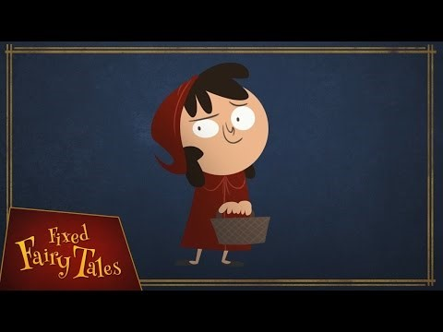
Fixed Fairy Tales
Little Red Riding Hood
As you watch the video, prepare to write some sentences to summarize the narrative.
Notes:
Video Link: https://www.youtube.com/watch?v=WG3_gnKSDh4
Watch video once with sound. Then, review with sound off, pausing to take suggestions for simple sentences to record under the tabs, following the format.

Slide 7
Good Sentences
Summarizing the narrative:
Now, we will review the video without sound.
As we pause, be prepared to offer suggestions for a simple sentence we can write to summarize each event in the narrative sequence. Remember our format:
Describer + Subject + Vivid Verb
For example, write this as our first sentence:
The cheerful girl meanders.

Slide 8
Good Sentences
Summarizing the narrative:
Now, we will review the video without sound.
As we pause, be prepared to offer suggestions for a simple sentence we can write to summarize each event in the narrative sequence. Remember our format:
Describer + Subject + Vivid Verb
For example, write this as our first sentence:
The cheerful girl meanders.

Slide 9
Good Sentences
Summarizing the narrative:
Now that we’ve completed the summary, go back and color code each of your simple sentences to match the colors on your superhero tabs.
Underline each describer, subject, and vivid verb using the color you used for that part of speech.
Describer + Subject + Vivid Verb

Slide 10
Action Parts of a
Sentence
Purpose: Now that you’ve created “Good Sentences,” we’re going to explore ways to strengthen those sentences.
Remember, it’s okay to use simple sentences – at times even necessary for variety – but you also want to be able to write better sentences.

Slide 11
Action Parts of a
Sentence
To strengthen your sentences, you need to develop strong action parts – these are added to the predicate or included as introductory phrases.
“Action parts” will modify the action of a sentence by telling: when, where, why, how, or adding doubt.

Slide 12
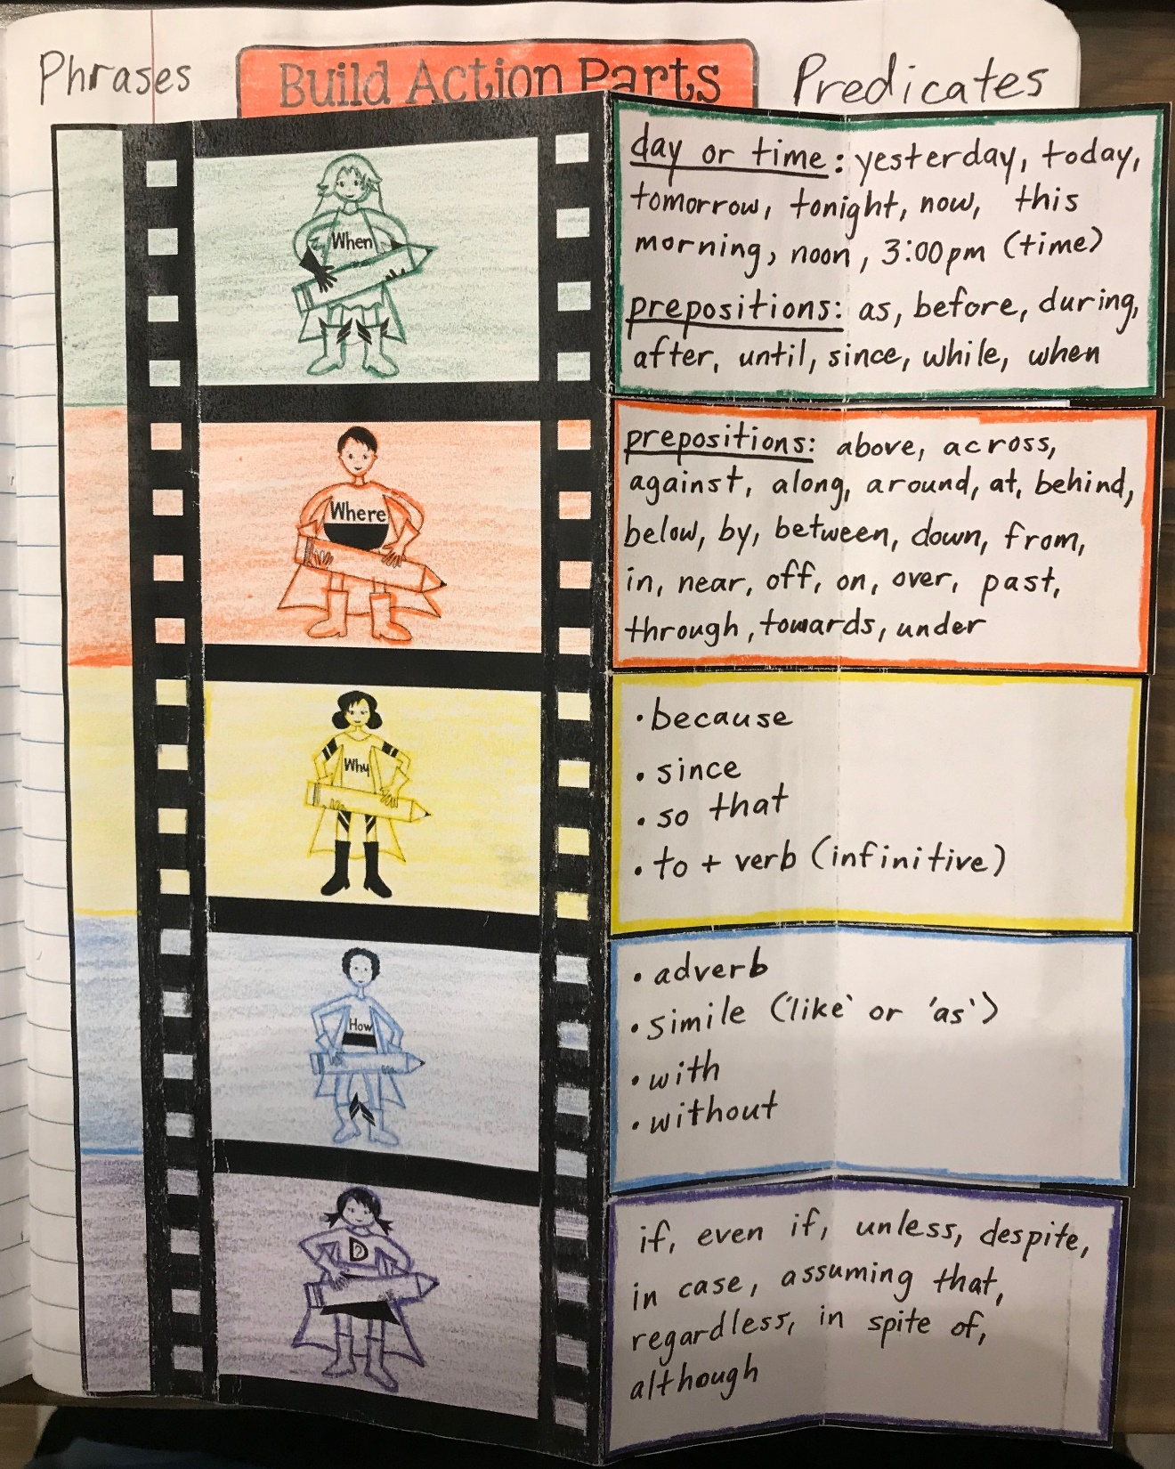
Action Parts of a
Sentence
Follow these steps to create the interactive notebook entry:
Begin by coloring in lightly and/or tracing the film reel. Choose different colors for each part; they should also be different than the 3 colors you used to color code the “Good Sentences” parts!
Cut around the perimeter of the film reel.
Write in the notes for each action part in the right column section as shown in the photo.
Fold this right section under the film reel (on the black line near the center). Flip it over and make a second vertical fold along the faint dotted line (see photos on next slide).

Slide 13
Notes for Action Parts Sections
WHEN | day or time: yesterday, today, tomorrow, tonight, now, this morning, noon, 3:00pm prepositions: as, before, during, after, until, since, while, when
WHERE | prepositions: above, across, against, along, around, at, behind, below, by, between, down, from, in, near, off, on, over, past, through, towards, under
WHY | • because • since • so that • to + verb ( infinitive)
HOW | • adverb (-ly) • simile (like or as) • with • without
DOUBT | if, even if, unless, despite, in case, assuming that, regardless, in spite of, although

Slide 14
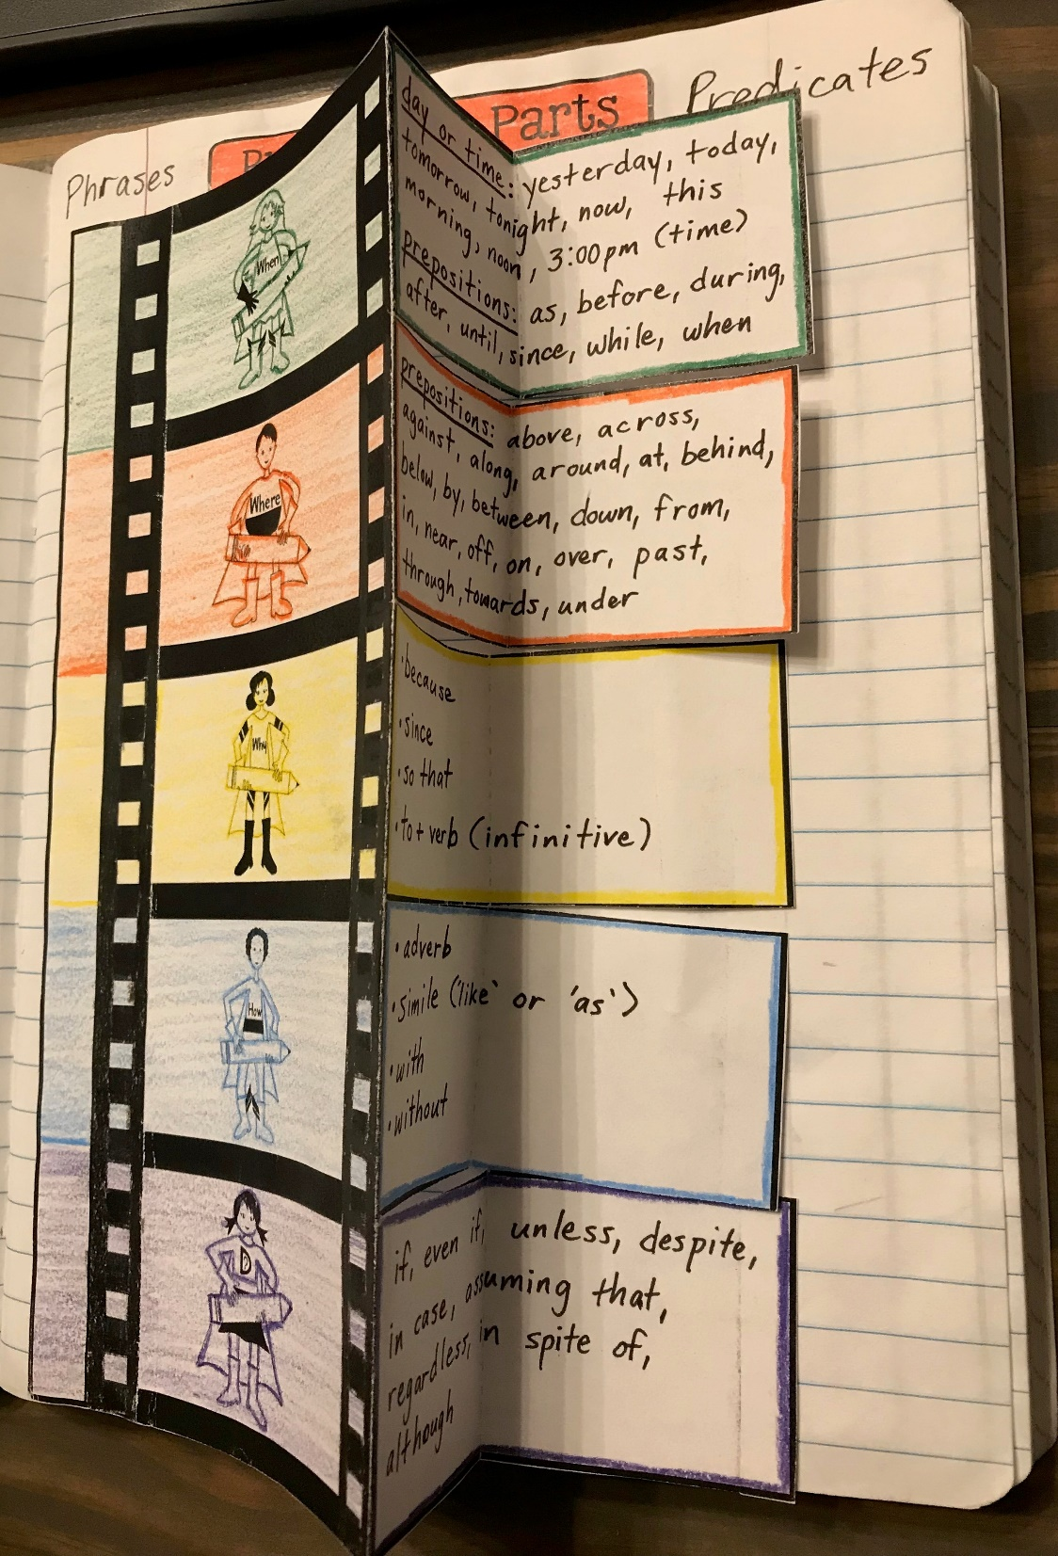
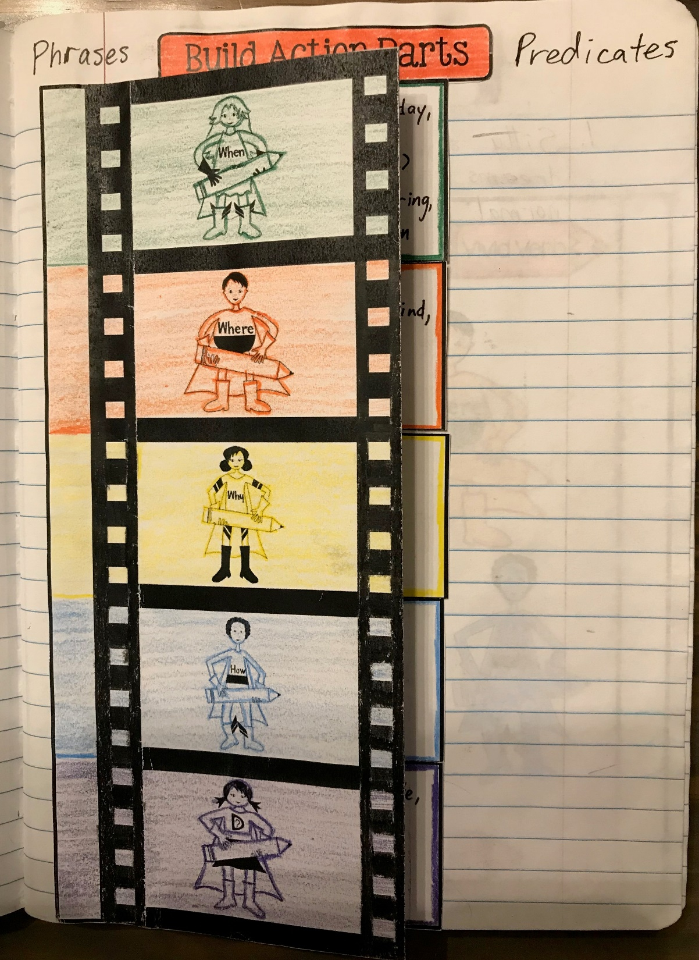
5. A small strip should stick out the right side.
6. Now, fold on the line on the left column of the film reel.
7. You’ll glue this tab down.
The rest of the film reel will be able to move freely.

Slide 15

Action Parts of a
Sentence
ALMOST DONE!!!
Using your scissors, carefully snip the rows up to the start of the movie reel as shown on the left.
Tuck each section under. Pull each section out as needed to use as a reference when writing sentences.
Add “Build Action Parts” to the Table of Contents in the front of your notebook.

Slide 16
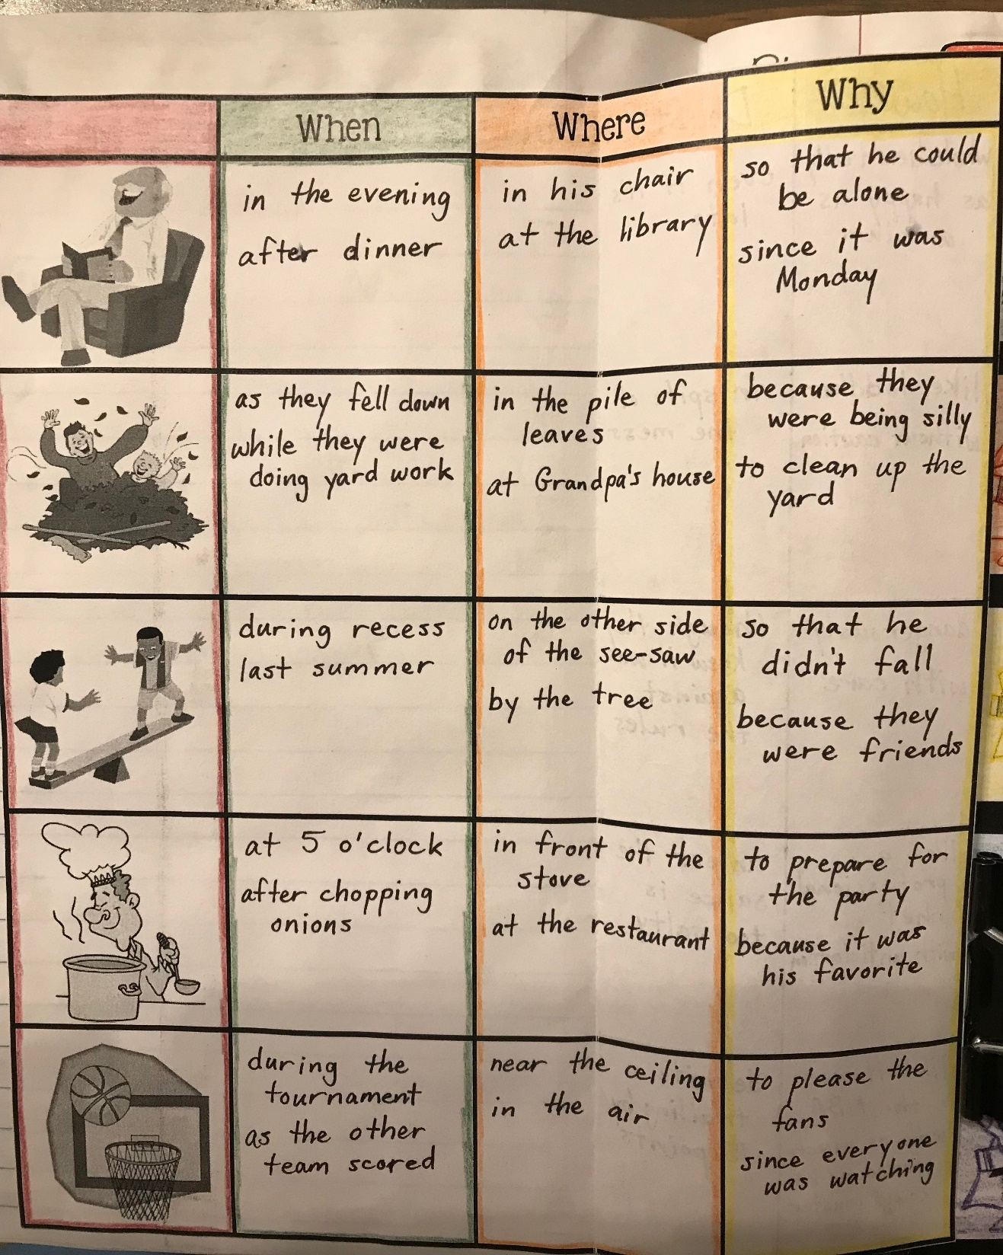
Action Parts of a
Sentence
Follow these steps to create the interactive notebook entry:
Using the SAME COLORS you used for part 1, color code by tracing around the boxes for each column.
Cut around the perimeter of the chart.
Fold the left edge over to meet the right edge of the first column (the one with the pictures).
PART TWO
You’ll have a crease/fold here.

Slide 17
Using your pencil, trace the horizontal lines from the first column to the edge of the crease so that you begin to make a new chart on the back. Use a ruler to help you make straight lines.
Split the middle of the back side with a vertical line so that you have two columns. Label the top of each column “How” and “Doubt.”

Slide 18
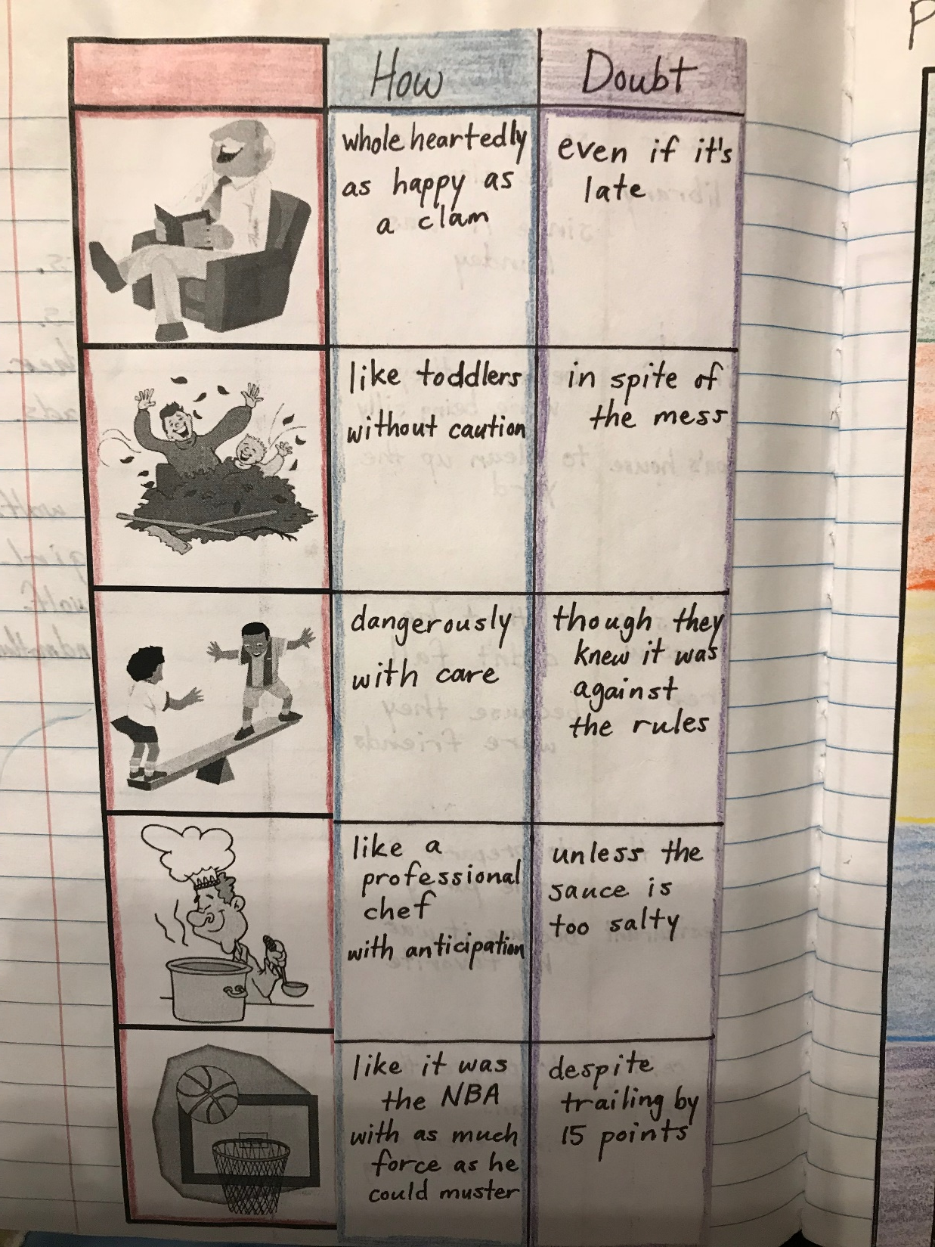
Using your pencil, trace the horizontal lines from the first column to the edge of the crease so that you begin to make a new chart on the back. Use a ruler to help you make straight lines.
Split the middle of the back side with a vertical line so that you have two columns. Label the top of each column “How” and “Doubt.”
Again, using the SAME COLORS you used for part 1, color code by tracing around the boxes for each column.
For each picture, write a phrase to modify the action by telling when, where, why, how, or adding doubt in the appropriate column.
(see examples on the next slide)

Slide 19
 | WHEN | WHERE | WHY | HOW | DOUBT
 | in the evening after dinner | in his chair at the library | so that he could be alone since it was Monday | wholeheartedly as happy as a clam | even if it’s late
 | as they fell down while they were doing yardwork | in the pile of leaves at Grandpa’s house | because they were being silly to clean up the yard | like toddlers without caution | in spite of the mess
 | during recess last summer | on the other side of the see-saw by the tree | so that he didn’t fall because they were friends | dangerously with care | though they knew it was against the rules
 | at 5 o’clock after chopping onions | in front of the stove at the restaurant | to prepare for the party because it was his favorite | like a professional chef with anticipation | unless the sauce is too salty
 | during the tournament as the other team scored | near the ceiling in the air | to please the fans since everyone was watching | like it was the NBA with as much force as possible | despite trailing by 15 points

