Slide 1
Types of Conflict
Elements of plot that
drive the narrative forward

Slide 2
What are you learning?
Learning Standards
Identify conflicts in narratives and determine the type of conflict.
5.RL.KID.1 Quote accurately from a text when explaining what the text says explicitly and when drawing inferences from the text.
5.RL.KID.2 Determine a theme or central idea of a story, drama, or poem from details in the text; summarize the text.
5.RL.KID.3 Compare and contrast two or more characters, settings, or events in a story or drama, drawing on specific details in a text.
5.RL.CS.5 Explain how a series of chapters, scenes, or stanzas fit together to provide the overall structure of particular texts.

Slide 3
What are you learning?
Conflict
Identify conflicts in narratives and determine the type of conflict.
Conflict: the result of competing desires or the presence of obstacles that need to be overcome¹
Conflict is necessary to propel a narrative forward; the absence of conflict amounts to the absence of story.¹
The plot pyramid that is used to track the structure of a narrative generally involves a series of conflicts (inciting incident, rising action and climax), which are ultimately resolved by the end of the narrative (falling action leads to the resolution of conflicts).
Comparing and contrasting narrative events, characters, and their interactions helps the reader identify and understand the conflicts in a story.
1. Source: Literary Devices website
http://www.literarydevices.com/conflict

Slide 4
What are you learning?
Conflict
Determine the type of conflict.
Conflict can be internal or external.
Internal conflict
Person (Man) vs. Self: Develops from a protagonist’s inner struggles, and may depend on a character trying to decide between good and evil or overcome self-doubts. This conflict has both internal and external aspects, as obstacles outside the protagonist force the protagonist to deal with inner issues.
External Conflict
Person vs. Person: A situation in which two characters have opposing desires or interests. The typical scenario is a conflict between the protagonist and antagonist.
Person vs. Nature: A character is tormented by natural forces such as storms or animals.
Person vs. Society: A character must take on society itself, and not a single person. The character stands at odds with societal norms and realizes the necessity to work against these norms.
Source: Literary Devices website
http://www.literarydevices.com/conflict
Notes:
Explain that in classic Literary theory, “Man” is used as a universal term to denote women as well, though more contemporary language is shifting to use the term “Person” in order to be more inclusive. Students may still encounter the term Man – instead of Person – in some texts that refer to types of conflict.

Slide 5
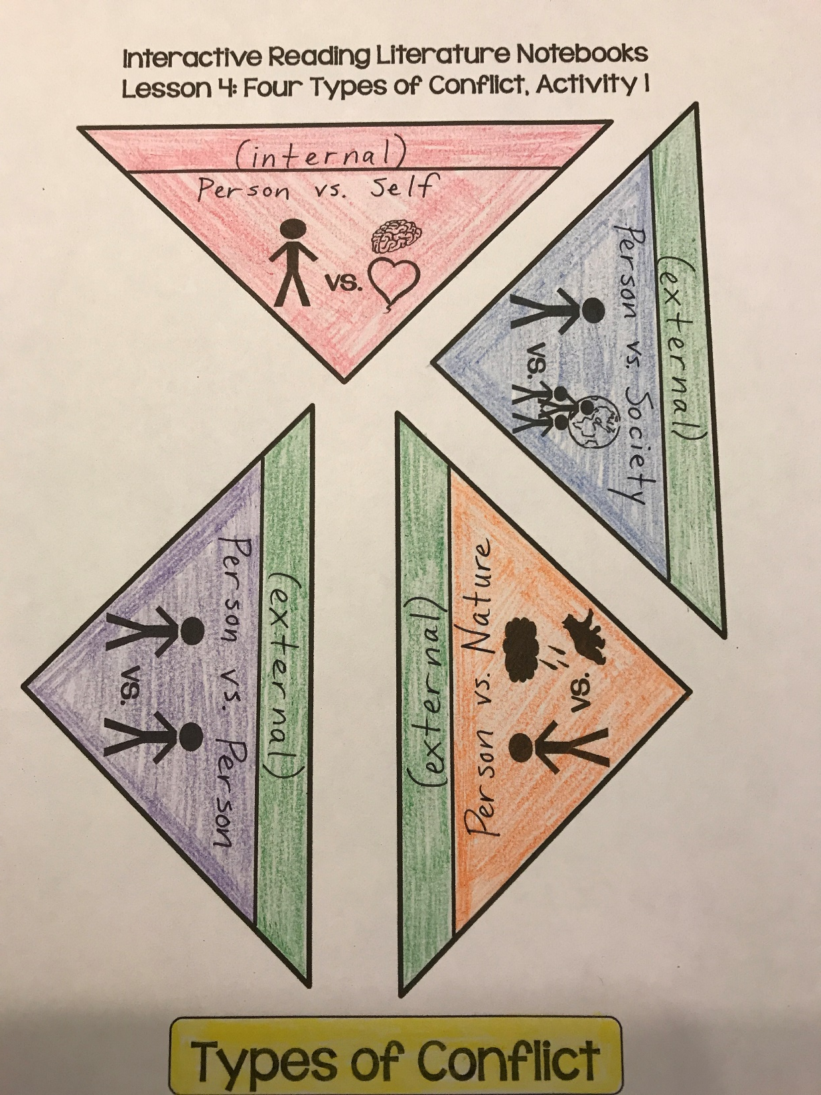
Interactive Notebook Entry
1. Label the tabs on each triangle either “internal” or “external” (see example!)
2. Shade the one “internal” tab red and the three “external” tabs green
3. Add the titles (“Person vs. _____”)

Slide 6
Interactive Notebook Entry
4. Lightly shade “Person vs. Self” red
5. Lightly shade “Person vs. Society” blue
6. Lightly shade “Person vs. Nature” orange
7. Lightly shade “Person vs. Person” purple
8. Lightly shade “Types of Conflict” yellow

Slide 7
Interactive Notebook Entry
FIND THE NEXT CLEAN PAIR OF PAGES
IN YOUR INTERACTIVE NOTEBOOK.
1. Cut out each piece separately, being careful to leave the tab on.
2. Place all pieces into the notebook so that the points of the triangle meet up.
3. Glue the tabs only so that pieces open.

Slide 8
Interactive Notebook Entry
4. Glue the title at the top of the page.
5. Use the matching color for each piece to trace a triangle on the notebook page.
6. Record the notes on the following page
under the correct triangle piece.

Slide 9
Interactive Notebook Entry
Types of Conflict
Types of Conflict Notes
(Record under the appropriate door.)
(Internal conflict)
Person vs. Self: a struggle between
a character and their feelings,
conscience, or fear
(External Conflict)
Person vs. Person: a struggle, mental or physical, between two characters; often involves the protagonist and antagonist
Person vs. Nature: a struggle between a character and natural forces (weather, animals, sickness, etc.)
Person vs. Society: a struggle between a character and the laws or beliefs of a group; could involve poverty, politics, social norms, expectations, or values

Slide 10
Types of Conflict
Cardboard
Analysis
Types of Conflict in Cardboard
Record the table below on the page facing your Types of Conflict interactive notebook entry.
Person vs. Self | Person vs. Person | Person vs. Nature | Person vs. Society

Slide 11
Types of Conflict
Cardboard
Analysis
Types of Conflict in Cardboard
List examples of each type of conflict found in the story in the correct column. Cite text evidence and explain.
Person vs. Self | Person vs. Person | Person vs. Nature | Person vs. Society
Notes:
Discuss as a whole group and complete a few together, then allow students time to add more independently. Possible ideas:
Person vs. Self – Mike: struggles to overcome the loss of Carol; Marcus/Cardboard Marcus: struggles with feelings of insecurity/living up to others’ expectations and fighting to overcome their inner nature; Bill: struggles to use the nuke to save mankind at the expense of losing his own life
Person vs. Person – Cam vs. Marcus; Bill vs. Death Boxer; Mike vs. Gideon; Mike vs. Marcus’s dad
Person vs. Nature – Bill: struggles with the notion of being “real” since he is made of cardboard; Cam/Mike and Marcus: playing God/creator by creating new life, which ultimately has major consequences for the world around them; Marcus: struggles with bipolar disorder
Person vs. Society – Mike: struggles with poverty and desire to provide a better life for Cam; Marcus: judged by Pink Eye and Cam/Mike for being wealthy, when some aspects of his character/personality traits/upbringing were beyond his control; Marcus vs. Cardboard Society: Marcus is deemed unworthy of being the king of the new Cardboard Kingdom because he is made of flesh

