Slide 1
Superman And Me
by Sherman Alexie

Slide 2
Learning Standards
5.RI.KID.2 Determine the main idea of a text and explain how it is supported by key details; summarize the text.
5.RI.KID.3 Explain the relationships and interactions among two or more individuals, events, and ideas in a text.
5.W.TTP.2 Write informative/explanatory texts to examine a topic and convey ideas and information.
5.W.PDW.4 Produce clear and coherent writing in which the development, organization, and style are appropriate to task, purpose, and audience
5.W.PDW.5 With guidance and support from peers and adults, develop and strengthen writing as needed by planning, revising, and editing.

Slide 3
I can statements
I can write an informative text to convey the main ideas of a topic.
I can develop ideas, organize information clearly, and use style that is appropriate to the writing task.
I can follow steps in the writing process to revise and edit my writing.

Slide 4
Summative Writing Task
In Sherman Alexie’s essay, “Superman and Me,” Alexie uses an extended metaphor to explain the connection between him and the fictional character Superman. Write an essay in which you explain the metaphor and trace its development throughout the essay.

Slide 5
Student Samples
We’re going to examine some examples of student writing.
First, we’ll review the Informational/Explanatory Writing Rubric. (You should have a copy in your Literacy notes!)
Be prepared to share your observations about the writing samples based on the rubric categories.

Slide 6
Kid-Friendly INFORMATIONAL Rubric | Development | Focus and Organization | Language | Conventions
4 | My facts and ideas support my focus. I use 4 or more facts or examples from the article. I connect the facts and examples to my focus. | My introduction has a clear focus. It hooks my readers! I organize my ideas by categories or topics. My ending relates to the information I presented. | I use topic-specific vocabulary to explain the topic. I use different types of sentences. My writing is formal and objective. | I use correct spelling, grammar, punctuation, and capitalization. There may be a few errors, but they don’t interfere with what I meant to say.
3 | Most of my facts and ideas support my focus. I use 2-3 facts or examples from the article. I connect most of the facts and examples to my focus. | My introduction has a clear focus but is not exciting to the reader. Most of my ideas are organized by categories or topics. My ending relates to most of the information. | I use some topic-specific vocabulary to explain the topic. I use some variety in my sentences. Most of my writing is formal and objective. | I usually use correct spelling, grammar, punctuation, and capitalization. There are some errors but they don’t interfere with what I meant to say.
2 | Very few facts and ideas support my focus. I used 1 or 2 facts or examples from the article. My facts are somewhat incorrect, repetitious, or merely listed. | My introduction does not have a clear focus. My ideas are not organized by categories or topics. My ending doesn’t relate to the information. | I use very little topic-specific vocabulary to explain the topic. I use very few different types of sentences. My writing is not consistently formal and objective. | I have not correctly used spelling, grammar, punctuation, and/or capitalization. The errors I have made interfere with what I meant to say.
1 | I did not support my focus with facts and ideas. I did not use facts or examples from the article. My facts are based on personal knowledge. | I did not write an introduction. My ideas are not organized in any way. I did not write an ending. | I do not use topic-specific vocabulary to explain the topic. Most of my sentences sound or look the same. My writing style is informal and conversational. | I did not pay attention to conventions. My errors make it hard to understand what I was trying to say.

Slide 7
Essential Questions for Revising/Editing
Did the writer (I) use facts and ideas to support the focus?
Did the writer (I) include facts/examples from the essay?
Did the writer (I) connect and explain the examples?
Did the writer (I) include an introduction with a clear focus?
Did the writer (I) organize ideas into paragraphs by categories or topics?
Did the writer (I) include an ending/conclusion that relates to the information?
Did the writer (I) include topic-specific vocabulary from the articles?
Did the writer (I) use different types of sentences that are formal/objective?
Did the writer (I) utilize correct spelling, grammar, punctuation, and capitalization?

Slide 8
Student Sample #1

Slide 9
FOCUS & ORGANIZATION
Student Sample #1
The writer introduces the topic—Alexie uses an extended metaphor to explain the connection between him and Superman—but the introduction is not exciting.
The ideas are organized into paragraphs by category/topic.
FOCUS: Some of the ideas in the essay are not clearly focused on explaining the connection between Sherman Alexie and Superman.
The ending relates to the rest of the essay, though it doesn’t summarize all the points the writer made to create a strong conclusion.

Slide 10
DEVELOPMENT
Student Sample #1
The writer uses at least 4 facts and examples from the essay, though not all of them are supported by quotes/text evidence.
Not all of the ideas are clearly connected to the focus; they could be more clearly explained…
Most of the ideas in the essay support the writer’s focus, though not all…
This idea hasn’t been introduced yet, and the text evidence really explains how Alexie, himself, broke through the reading barrier.
This transition is very abrupt. The writer misses an opportunity here to make a stronger connection by sharing text evidence to describe the students he is trying to save.
As noted, the conclusion could be further developed by explaining all the text evidence used to show how Alexie develops his metaphor.

Slide 11
LANGUAGE
Student Sample #1
The writer uses some topic-specific vocabulary to explain the topic. However, they could have included more citations and direct quotes when sharing text evidence.
The writer does a good job of including a variety of different types of sentences.
The writing style is formal and objective, with only occasional informal vocabulary choices. The essay maintains third person point of view.

Slide 12
CONVENTIONS
Student Sample #1
The writer generally uses correct spelling, grammar, punctuation, and capitalization.
There are occasional errors, but they don’t interfere with the overall meaning.

Slide 13
Essential Questions for Revising/Editing
Did the writer (I) use facts and ideas to support the focus?
Did the writer (I) include at least four (4) facts/examples from the articles?
Did the writer (I) connect and explain the examples?
Did the writer (I) include an introduction with a clear focus?
Did the writer (I) organize ideas into paragraphs by categories or topics?
Did the writer (I) include an ending/conclusion that relates to the information?
Did the writer (I) include topic-specific vocabulary from the articles?
Did the writer (I) use different types of sentences that are formal/objective?
Did the writer (I) utilize correct spelling, grammar, punctuation, and capitalization?
While the author of Sample #1 captures the general idea of the writing prompt, there are still some errors that could be improved. It includes facts and evidence from Alexie’s essay, but some of the evidence does not support the focus. The extended metaphor could also be more clearly explained. This essay would earn a “3” overall – good, but not great!

Slide 14
Essential Questions for Revising/Editing
Did the writer (I) use facts and ideas to support the focus?
Did the writer (I) include at least four (4) facts/examples from the articles?
Did the writer (I) connect and explain the examples?
Did the writer (I) include an introduction with a clear focus?
Did the writer (I) organize ideas into paragraphs by categories or topics?
Did the writer (I) include an ending/conclusion that relates to the information?
Did the writer (I) include topic-specific vocabulary from the articles?
Did the writer (I) use different types of sentences that are formal/objective?
Did the writer (I) utilize correct spelling, grammar, punctuation, and capitalization?
We’ll review one more example together. This time, read the sample quietly to yourself. After reading, be prepared to share your observations about the essay. Use your Informational Writing Rubric to analyze the author’s work.
How would you provide specific feedback to this student?

Slide 15
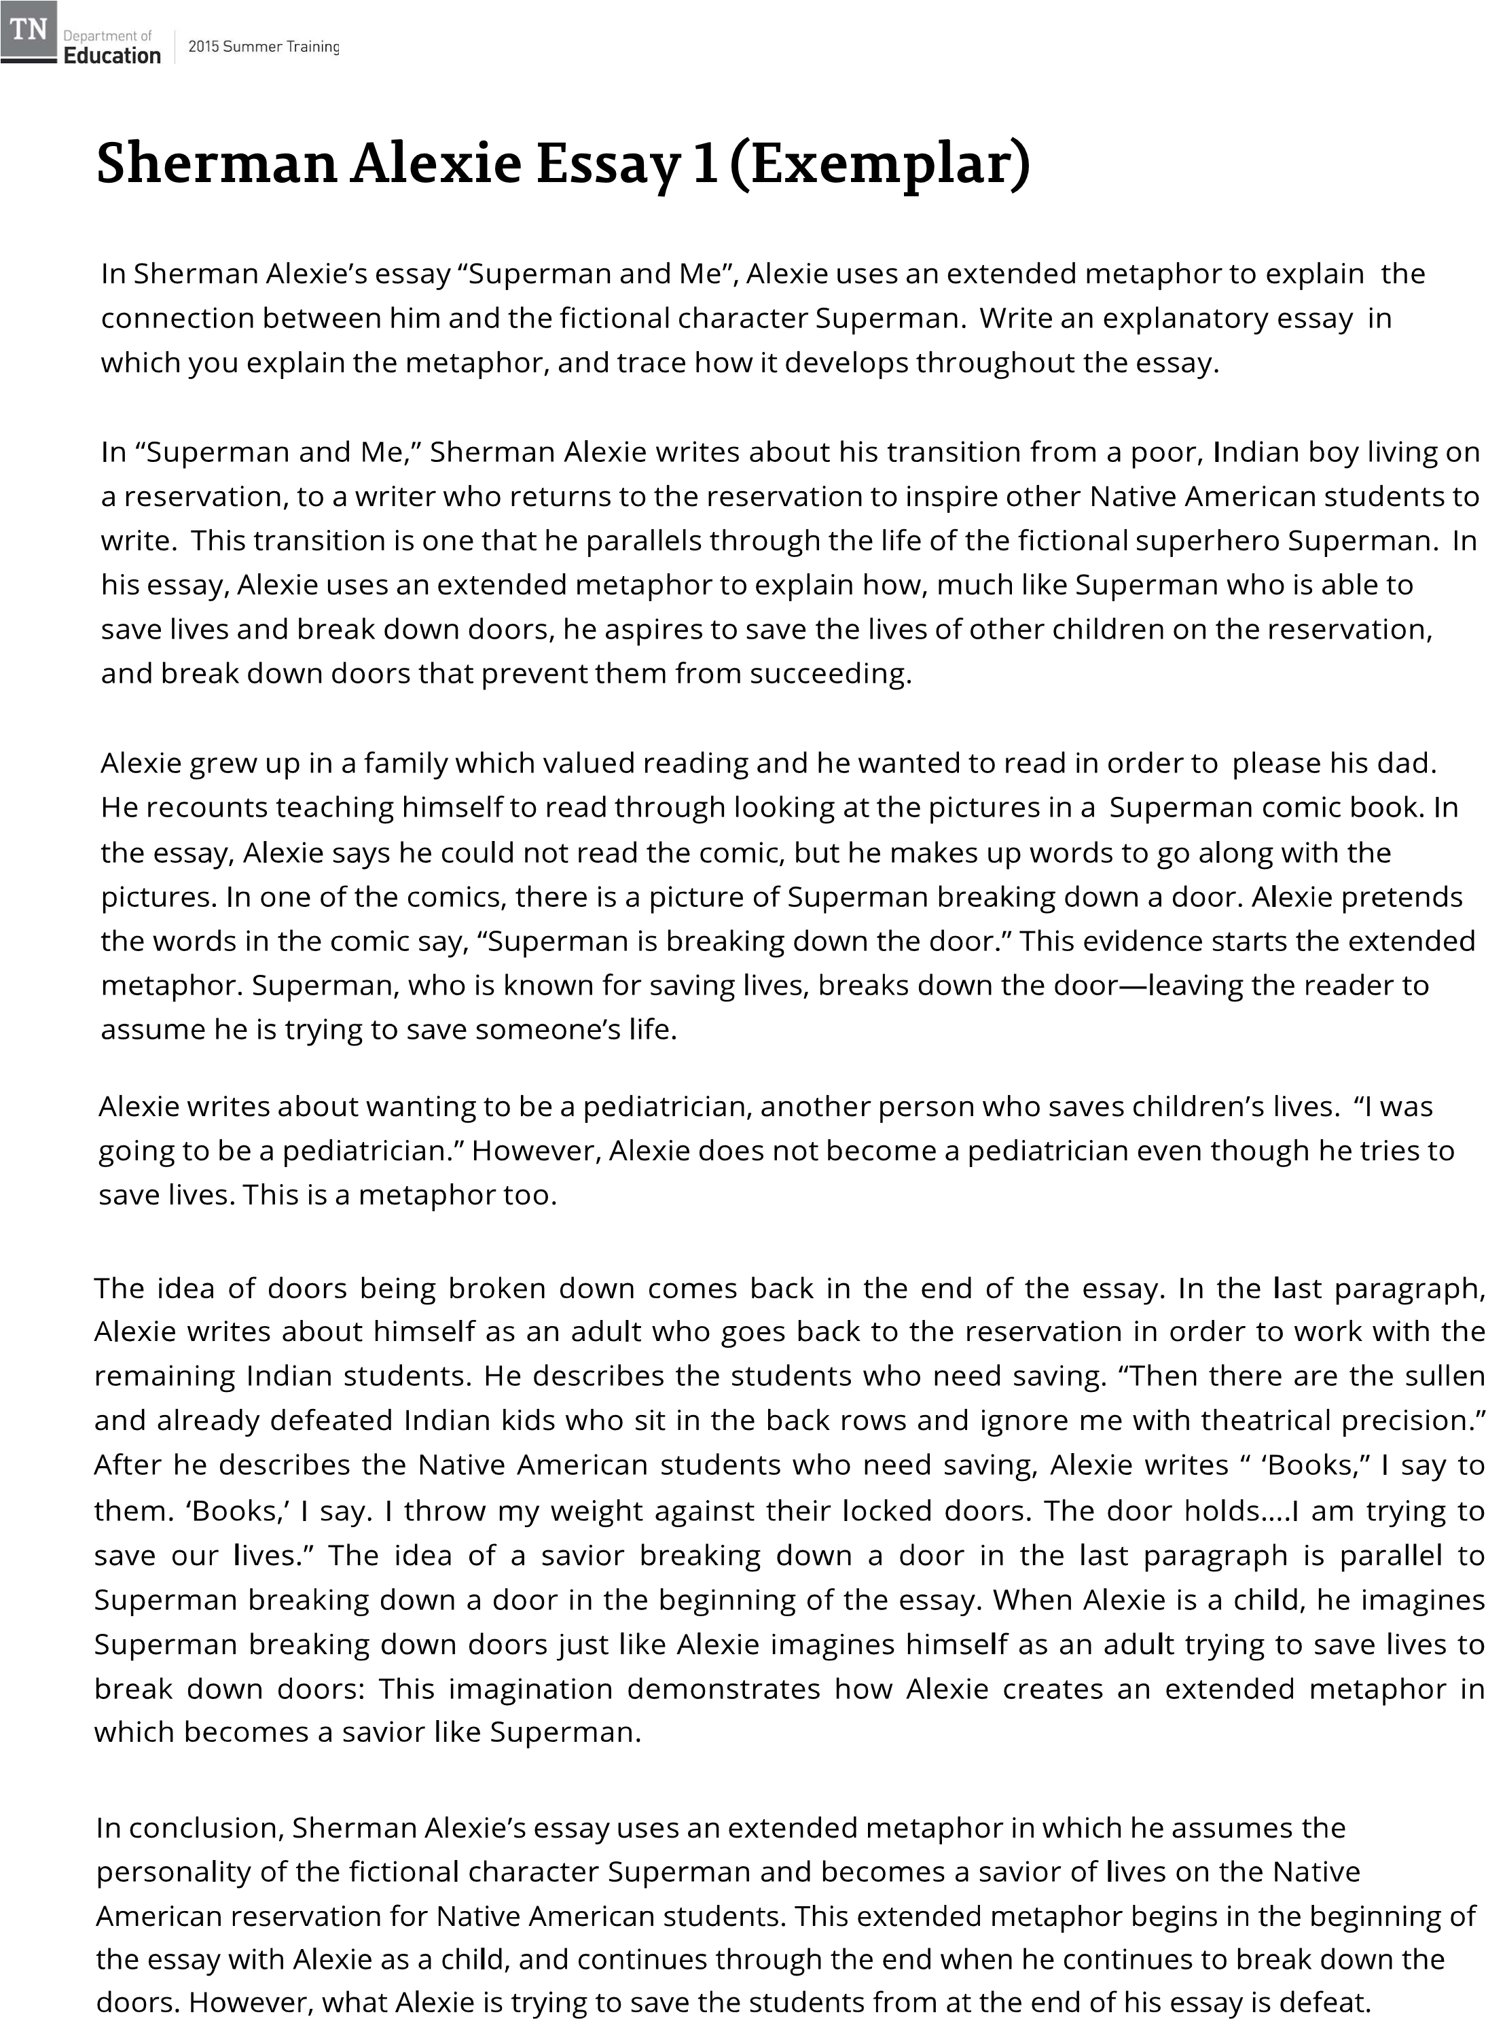
Student Sample #2
In conclusion, Sherman Alexie’s essay uses an extended metaphor in which he assumes the personality of the fictional character Superman and becomes a savior of lives on the Native American reservation for Native American students. This extended metaphor begins in the beginning of the essay with Alexie as a child, and continues through the end when he continues to break down the doors. However, what Alexie is trying to save the students from at the end of his essay is defeat.

Slide 16
Essential Questions for Revising/Editing
Did the writer (I) use facts and ideas to support the focus?
Did the writer (I) include at least four (4) facts/examples from the articles?
Did the writer (I) connect and explain the examples?
Did the writer (I) include an introduction with a clear focus?
Did the writer (I) organize ideas into paragraphs by categories or topics?
Did the writer (I) include an ending/conclusion that relates to the information?
Did the writer (I) include topic-specific vocabulary from the articles?
Did the writer (I) use different types of sentences that are formal/objective?
Did the writer (I) utilize correct spelling, grammar, punctuation, and capitalization?
Sample #2 is much more polished. Not only does the writer introduce the topic, but they also clearly focus on tracing the development of the extended metaphor. All ideas support this focus and are explained with clear text evidence. The author concludes the essay with a strong summary of the metaphor. This sample would receive a grade of “4.”

Slide 17
Peer Review
Working with a partner, Follow these steps to review your writing:
Determine who is “Partner #1” (the person with the longest hair).
Partner #1 will read their writing aloud to Partner #2 (who is following along silently).
Partner #2 will complete the “Peer Writing Review Sheet” to give Partner #1 feedback.
During this time, ask questions as needed to clarify things you don’t understand, etc.
SWITCH: Partner #2 will read their writing aloud to Partner #1 (who is following along silently).
Partner #1 will complete the “Peer Writing Review Sheet” to give Partner #2 feedback.
Again, ASK QUESTIONS! Help each other out. The goal is to improve your writing.

Slide 18
Essential Questions for Revising/Editing
Did the writer (I) use facts and ideas to support the focus?
Did the writer (I) include facts/examples from the essay?
Did the writer (I) connect and explain the examples?
Did the writer (I) include an introduction with a clear focus?
Did the writer (I) organize ideas into paragraphs by categories or topics?
Did the writer (I) include an ending/conclusion that relates to the information?
Did the writer (I) include topic-specific vocabulary from the articles?
Did the writer (I) use different types of sentences that are formal/objective?
Did the writer (I) utilize correct spelling, grammar, punctuation, and capitalization?

Slide 19
Publishing a Final Draft
Using the feedback from your partner, revise/edit your writing to publish a final draft. Be sure you have included strong text evidence that clearly supports your focus, and explain how the evidence is used to develop the extended metaphor!
In Sherman Alexie’s essay, “Superman and Me,” Alexie uses an extended metaphor to explain the connection between him and the fictional character Superman. Write an essay in which you explain the metaphor and trace its development throughout the essay.

