Slide 1
Prepositions
5th grade Literacy

Slide 2
Today’s Schedule
Finish Peer Review Process
Preposition Notes
Above & Beyond: start IXL sections Z.2, Z.3, & Z.4

Slide 3
Definition: Prepositions
A preposition is a word that shows the connection between other words in the sentence.
Some prepositions are used to show time, location, and direction.
Other prepositions, such as with and about provide details.

Slide 4
Definition: Prepositional Phrase
A prepositional phrase begins with a preposition & ends with a noun or pronoun
The noun or pronoun is the object of the preposition

Slide 5
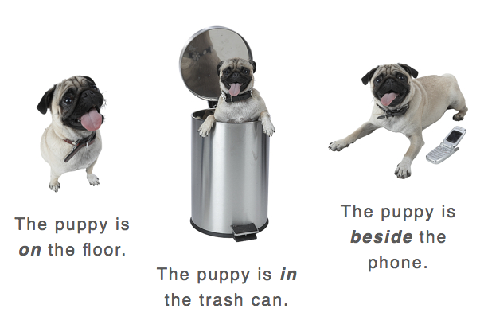
Examples

Slide 6
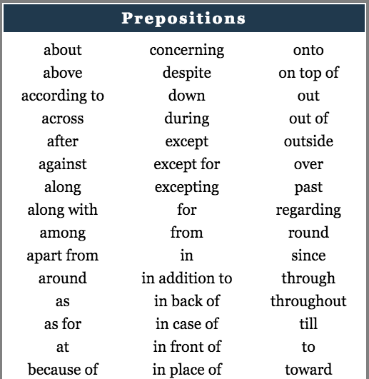
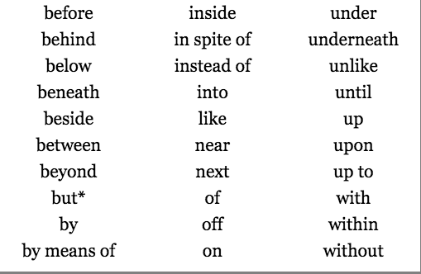
Examples

Slide 7
Let’s Practice!
Directions: Put brackets around the prepositional phrase. Circle the preposition & underline the noun/pronoun (object of the preposition).
Mr. Johnson walked his dog across the street.
Adrian leaned against the tree.
Put the papers by the recycling bin.
Henry put his toys under his bed.
There are multiple materials in the bin.
The teachers worked throughout the day.
The dog with the spots is mine.
The school’s entrance faces toward the apartment building.

Slide 8
Flocabulary Video
Prepositions—Riding Through the City
Fill in the blanks as you watch the Flocabulary video!

Slide 9
IXL Sections
Complete IXL sections Z.2, Z.3, & Z.4
Make sure that you receive a smart score of 85 or higher ☺
(Above & Beyond): continue working on your final draft

