Slide 1
Prefixes & suffixes
5th grade Literacy

Slide 2
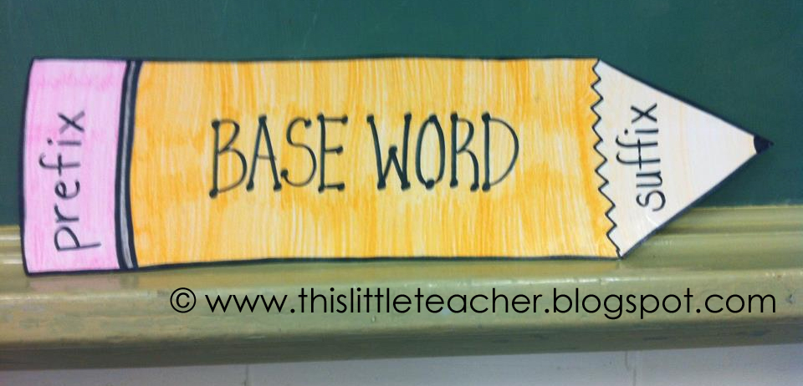
{Schedule}
Bell-Ringer
Flocabulary Video: Prefixes
Prefixes: Notes & Foldable
Flocabulary Video: Suffixes
Suffixes: Notes & Foldable
Team Practice
Independent Practice
Exit-Ticket
Daily 5

Slide 3
{Flocabulary Video: Prefixes}
Directions: As you watch the Flocabulary videos, fill in the blanks within the lyrics!

Slide 4
{Base Words}
Teammate Practice:
Played
Running
Quickly
Reheat
A base word is a complete word that can stand alone. It does not need help from a prefix or suffix for meaning.
Example: teach, play

Slide 5
{Prefixes}
A prefix is a word part added to the beginning of a root or base word.
They change the meaning of the base word.
Teammate Practice:
Redo
Unhappy

Slide 6
{Foldable: Prefixes}
Prefix: | Meaning: | Examples:
dis-- | Do the negative or opposite | dislike, disown
un-- | Not or opposite | unfair, unsure
pre-- | before | precook, pretest
mis-- | not, wrongly | misunderstood, misjudge
ex-- | from, out, away from | exit, excerpt

Slide 7
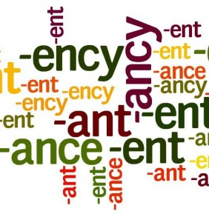
{Flocabulary Video: Suffixes}
Directions: As you watch the Flocabulary videos, fill in the blanks within the lyrics!

Slide 8
{Suffixes}
A suffix is a word part added to the end of a root or base word.
They change the meaning of the base word.
Teammate Practice:
Wonderful
Loudly

Slide 9
{Foldable: Suffixes}
Suffix: | Meaning: | Examples:
--er | a person who | singer, teacher
--er | compares two things | taller, happier
--ful | full of | peaceful, successful
--ly | in what manner | poorly, sickly
--ness | state or quality | kindness, sadness

Slide 10
{Team Practice}
Directions: Read the following sentences. Define the underlined word.
1. His sickness made him miss school last Tuesday.
Sickness means: ___________________________
2. Madison Bumgarner, the pitcher for the San Francisco Giants, led his team to a World Series win!
Pitcher means: ___________________________

Slide 11
{Independent Practice}
Please work independently and quietly on your independent practice.
Above & Beyond: Roll a dice to complete the activity included at the end of your independent practice!

Slide 12
{Exit Ticket}
Directions: On a post-it note, write your name and answer the following question:
How can you use your knowledge of prefixes and suffixes to define an unknown word?

Slide 13
[Daily 5]
Table 1 & 2: Work on Writing
(1) Should girls and boys be able to play on the same sports team?
(2) Eleanor Roosevelt once said, "You must do the thing you think you cannot do." Write a narrative about a time when you did something you thought you could not do.
(3) If you could live inside any video game, which would you choose? Why?
Table 3 & 4: Word Work
Required: Make flashcards for your vocabulary words and quiz a partner.
Optional: If you finish, you may use the white boards to quiz each other on your spelling words
Tables 5: Read to Self
Tables 6: Read with Someone

