Slide 1
Point of View
It’s all about Perspective!

Slide 2
Standards and Objectives
5.RL.CS.6 Describe how a narrator’s or speaker’s point of view influences how events are described.
I can determine the point of view in a text and explain how it influences the way events are described.
Create a new entry in your Table of Contents titled Point of View.
Turn to the next empty page in your notebook.
Write this I can statement at the top of the page!

Slide 3
Essential Questions
Consider the following questions as we learn together today. Be ready to discuss!
  How do we identify the point of view in a text?
  What are the differences between first person and third person point of view?
  What are the similarities/differences between third person limited and third person omniscient points of view?

Slide 4
BrainPOP “Point of View” Video
BrainPOP: Point of View

Slide 5
Word Families/Root Words
Limited
  What does it mean to limit something? Where have you seen that word?
Omniscient
  Word Origin: Latin, from omnis: all : universally
Objective
  Pick one up!!! (i.e. an object at your desk)

Slide 6
Point of View Foldable
The finished product
will look like this:
(We won’t color today, but if you would like to add color to your foldable later, feel free to do so – just make sure you can still read the notes!)

Slide 7
Point of View Foldable
Follow the directions to construct your foldable:
  1) Cut out each window and curtain. Be careful to cut around the outside edges (lines).
  2) Cut out one of the headings (Point of View).
  3) Fold the top of the curtains down to create a crease.
  4) Glue them on at the top of the windows so that the tabs swing open from the top (as shown).
  5) Glue the windows into your notebook (as shown).
  6) Write the definition for each type of point of view under the tab/curtain onto the window.

Slide 8
Vocabulary Definitions
point of view: the position from which a narrator sees and understands what is happening (Write this definition below your heading.)
first person point of view: told from the viewpoint of one of the characters using the pronouns “I” and “we”
third person limited point of view: the narrator is an outside observer who focuses on the thoughts and feelings of only one character

Slide 9
Vocabulary Definitions
third person omniscient point of view: the narrator is an outside observer who can tell us the thoughts and feelings of all of the characters in a story
third person objective point of view: the narrator reports the facts of a story as a neutral and impersonal outside observer

Slide 10
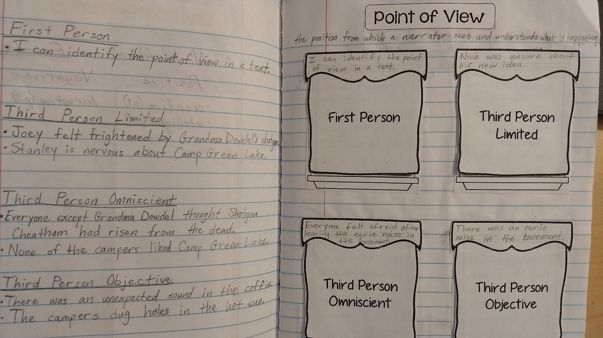
Sentence-Writing
On the opposite page, create a heading for each point of view, underline it, and skip four lines before creating the next point of view.

Slide 11
Sentence-Writing
Write 2-3 example sentences for each point of view.
Examples
  First Person: I can identify the point of view.
  Third Person:
    Limited: August was nervous about going to school.
    Omniscient: Everyone felt afraid after hearing the eerie noise in the basement.
    Objective: There was an eerie noise in the basement.
Above and Beyond: Write examples of books you’ve read that are written in a certain point of view on the curtains.

Slide 12
Partner Discussion: Think, Pair, Share
Share the sentences you wrote for each point of view with your shoulder partner:
  1) Swap composition journals.
  2) Read your partner’s example sentences.
  3) Offer positive feedback for correct sentences, or give suggestions for corrections.

Slide 13
Essential Questions
Group Discussion: Now that we’ve learned more about point of view, let’s discuss what we’ve learned together!
  How do we identify the point of view in a text?
  What are the differences between first person and third person point of view?
  What are the similarities/differences between third person limited and third person omniscient points of view?

Slide 14
Exit Ticket
Independent Writing
Write a response to the following question on your sticky note:
How does the point of view influence the way events are described in a narrative?

Slide 15
Bell Ringer
Directions: Read the following passage carefully. Rewrite the passage as if it were told in first person point of view. DO NOT leave out any information.
Jane couldn’t believe what she was seeing! She arrived home from school to discover that her dog had torn her science fair project to shreds. “All of my hard work is ruined!” she thought. “Two months of experimenting down the drain!” She became very angry and was ready to yell at her dog. Then, she decided to use the Emoger, go for a walk. “I’m so angry at my dog,” Jane thought to herself as she walked around her neighborhood. “But, yelling at him won’t fix anything. I’ll wait for Mom to get home. She’ll know what to do.”

Slide 16
Essential Questions
Group Discussion: Review what we’ve learned about point of view by answering the following questions together!
  Name the five different points of view.
  Explain the differences between first person and third person point of view.
  How does a narrator’s point of view influence how events in a narrative are described?

Slide 17
Identifying Point of View
Each of the following slides contains a short excerpt from a literary or informational text.
Read the text carefully to determine the point of view.
Write the point of view on the line on your recording sheet.
You may use the notes in your interactive notebook for help.

Slide 18
Example Passage #1
Sideways Stories from Wayside School
by Louis Sachar
Leslie sat in front of Paul. She had two long, brown pigtails that reached all the way down to her waist. Paul saw those pigtails, and a terrible urge came over him. He wanted to pull a pigtail. He wanted to wrap his fist around it, feel the hair between his fingers, and just yank. He thought it would be fun to tie the pigtails together, or better yet, tie them to her chair. But most of all, he just wanted to pull one.

Slide 19
Example Passage #2
Invitation to the Game by Monica Hughes
And we scrounged. Next to survival, scrounge was probably the most important word in our new vocabulary. We found a store that was throwing out water-damaged mattresses. Getting them home was a problem, since we had to make two trips, leaving Brad and Katie, armed with sticks to guard over the remained. I truly expected them to be challenged by some gang boss, but they said that the only person who came by was a scrawny little rat of a girl living alone. We let her have one of the mattresses.

Slide 20
Example Passage #3
Tuck Everlasting by Natalie Babbitt
At dawn, Mae Tuck set out on her horse for the wood at the edge of the village of Treegap. She was going there, as she did once every ten years, to meet her two sons, Miles and Jesse, and she was feeling at ease. At noon time, Winnie Foster, whose family owned the Treegap wood, lost her patience at last and decided to think about running away.

Slide 21
Example Passage #4
Curious George and the Pizza by Margret Rey
At the pizza place, Tony the baker was getting the pizzas ready for baking. He flattened out a ball of dough into a large pancake and tossed it in the air. He spread tomato sauce on it, sprinkled it with cheese, and shoved it in the oven. Then the telephone rang. "A fellow from the factory wants a large pizza delivered in a hurry," Tony's wife called. "OK, I'll get my coat," said Tony.

Slide 22
Example Passage #5
The Baffled Parent's Guide to Great Basketball Drills by Jim Garland
Before each practice begins, make sure you check the court and remove any debris from the playing surface. When your players arrive, check that they have the proper footwear and that they've removed any jewelry, which could injure the player wearing the jewelry or another player. Always carry a list of emergency phone numbers for your players, and know where the nearest phone is located. You should also have a first-aid kit, and you might want to take a first-aid course.

Slide 23
Example Passage #6
The Ninja Housewife by Deborah Hamlin
After dropping her son off at school, Sara sat at a traffic light and waited. She was on her way to her office job as a secretary in a law office. It was mainly paperwork with very little time to interact with other people, but Sara had gotten used to that. It also gave her plenty of time to daydream, something she had also gotten quite used to. She was a woman in her mid-30s, married 13 years, with one child.

Slide 24
Example Passage #7
The Patchwork Girl of Oz by Lyman Frank Baum
Unc Nunkie, Margolotte and the Magician all stood looking at the marvelous Powder, but Ojo was more interested just then in the Patchwork Girl's brains. Thinking it both unfair and unkind to deprive her of any good qualities that were handy, the boy took down every bottle on the shelf and poured some of the contents in Margolotte's dish. No one saw him do this, for all were looking at the Powder of Life; but soon the woman remembered what she had been doing, and came back to the cupboard.

Slide 25
Example Passage #8
How to grill by Steven Raichlen
Once you have your grill assembled, the next thing to decide is where to put it. A grill puts out a lot of heat, so you should position it several feet away from the side of the house or any plants or shrubbery. You'll have an easier time with a spot that is sheltered from the wind. When positioning a grill on a wooden deck, remember that sparks and live embers can fall from a charcoal grill.

Slide 26
Example Passage #9
Anne of Green Gables by L. M. Montgomery
Marilla's lips twitched understandingly. She had expected Mrs. Rachel to say this; she had known that the sight of Matthew jaunting off so unaccountably would be too much for her neighbor's curiosity. If Marilla had said that Matthew had gone to Bright River to meet a kangaroo from Australia Mrs. Rachel could not have been more astonished. She was actually quiet for five seconds. It was unsupposable that Marilla was making fun of her, but Mrs. Rachel was almost forced to suppose it.

Slide 27
Example Passage #10
Alice's Adventures in Wonderland by Lewis Carroll
Alice was beginning to get very tired of sitting by her sister on the bank, and of having nothing to do: once or twice she had peeped into the book her sister was reading, but it had no pictures or conversations in it, "and what is the use of a book," thought Alice, "without pictures or conversations?" So she was considering, in her own mind whether the pleasure of making a daisy-chain would be worth the trouble of getting up and picking the daisies, when suddenly a White Rabbit with pink eyes ran close by her.

Slide 28
Example Passage #11
Shiloh by Phyllis Reynolds Naylor
The day Shiloh come, we're having us a big Sunday dinner. Dara Lynn's dipping bread in her glass of cold tea, the way she likes, and Becky pushes her beans over the edge of her plate in her rush to get 'em down. Ma gives us her scolding look. We live high up in the hills above Friendly, but hardly anybody knows where that is. Friendly's near Sistersville, which is halfway between Wheeling and Parkersburg. Used to be, my daddy told me, Sistersville was one of the best places you could live in the whole state.

Slide 29
Example Passage #12
The Skull of Truth: A Magic Shop Book by Bruce Coville, Gary A. Lippincott
To his astonishment, Charlie found himself standing next to his bicycle, back where he had entered the swamp. That was bizarre and upsetting, but not as bad as the realization that he was still holding the skull. He thought he had dropped it before he raced out the door. He certainly hadn't intended to steal the thing. He didn't even really want it!

Slide 30
Example Passage #13
From the Mixed-up Files of Mrs. Basil E. Frankweiler by E. L. Konigsburg
Claudia knew that she could never pull off the old-fashioned kind of running away. That is, running away in the heat of anger with a knapsack on her back. She didn't like discomfort; therefore, she decided that her leaving home would not be just running from somewhere but would be running to somewhere. To a large place, a comfortable place, an indoor place, and preferably a beautiful place. And that's why she decided upon the Metropolitan Museum of Art in New York City.

Slide 31
Example Passage #14
White Fang by Jack London
They spoke no more until camp was made. Henry was bending over and adding ice to the bubbling pot of beans when he was startled by the sound of a sharp snarling cry of pain from among the dogs. Henry grunted with a tone that was not sympathy, and for a quarter of an hour they sat on in silence, Henry staring at the fire, and Bill at the circle of eyes that burned in the darkness just beyond the firelight.

Slide 32
Example Passage #15
Mary Poppins by P. L. Travers, Mary Shepard
They found themselves in bed and watching, by the dim light from the night-light, the rest of Mary Poppin's unpacking being performed. From the carpet bag she took out seven flannel nightgowns, four cotton ones, a pair of boots, a set of dominoes, two bathing-caps and a postcard album. Jane and Michael sat hugging themselves and watching. It was all so surprising that they could find nothing to say. But they knew, both of them, that something strange and wonderful had happened at Number Seventeen, Cherry-Tree Lane.

Slide 33
BrainPOP Quiz
You have learned to identify the point of view in a text.
Show what you know as you test your knowledge with the BrainPOP Point of View Quiz!

