Slide 1
Making Inferences
5th grade Literacy

Slide 2
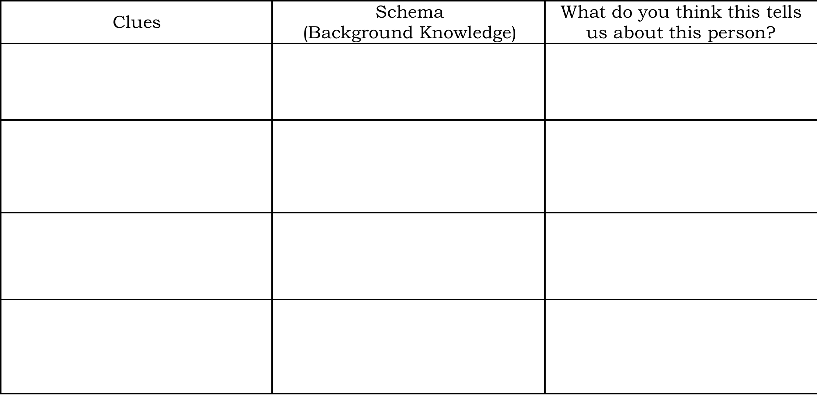
{Mystery Mail}
As your classmate pulls out each item from the mystery envelope, write down each item under the “Clues” section.
You are going to use the clue, combined with your schema, or background knowledge, to figure out who sent the mystery mail.

Slide 3
{Schedule}
Bell-Ringer Sheet
Mystery Mail Activity
Objectives & Goal Setting
Guided Notes
Team Practice
Teammate Practice (Walk the Room)
Independent Practice/ Exit Ticket

Slide 4
{Objectives}
I CAN...state the difference between an inference & a prediction.
I CAN...draw inferences from a text.

Slide 5
{Goal Setting}
What is your personal goal for today? What do you want to accomplish by the end of today’s class period?
Your goal should...
Be specific
Be reasonable
Relate to today’s lesson

Slide 6
{Definition: Inferences}
An inference has two components.
When making an inference, we use clues and our schema or background knowledge.
There is a difference between an inference and a prediction.
Inference | Prediction
Use background knowledge & textual evidence May not be answered by the end of the story. Reading between the lines | Focuses on what happens in the text Will find out if you’re right or wrong

Slide 7
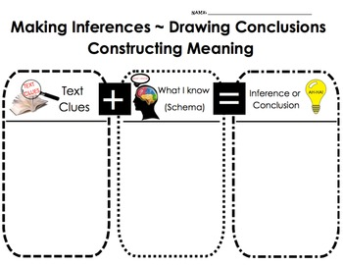
{Making Inferences Equation}
Remember this equation as you become an inferences detective!

Slide 8
{Stop & Jot Questions}
Answer the following questions! Be sure to restate the question & use complete sentences☺
[Stop & Jot #1]: How can you utilize this skill in your everyday life? Provide an example of making inferences in a real-world situation.
[Stop & Jot #2]: How can making inferences help you better understand a story or text?

Slide 9
{Team Practice: Example #1}
Norman had two tickets for a sporting event. He saw his best friend Carter walking past him. Norm said, “Look, I have two tickets to the basketball game!”
“What is that supposed to mean?” snarled Carter.
Based on the text, how does Carter feel?
Text Clues + Schema = Inference

Slide 10
{Team Practice: Example #2}
Dolphins have a poor sense of smell. In order to distinguish different types of fish, they have to taste the water around them. But, their vision is excellent and keeps them from bumping into things.
Based on the information in the text, what can a reader infer?
Text Clues + Schema = Inference

Slide 11
{Team Practice: Example #3}
[The Bet]
Day twisted into night and Carissa was still sitting in the same place that she had been. It was an ordinary day, and yet there seemed to be an intangible mist in the air. Something just wasn’t quite right and Carissa knew it although she could not explain how she knew. If everything had gone as planned, Alex would be back from doing the prank and old Mr. Wilson would be sitting on his porch as grumpy as usual fanning away anything and anyone that passed by his perfectly cut lawn. What was it with him anyway?
After another hour had passed, Carissa could feel her stomach flounder inside. Still she had apprehension about calling Alex or any of her other friends.
Question: Carissa is waiting to hear from her friend Alex. How do you think the prank went? Use evidence from the text & your background knowledge to support your answer.

Slide 12
{Teammate Practice: Walk the Room}
Directions:
There are 6 different posters throughout the room.
Visit each of the posters. Read the task carefully & follow the directions.
Make sure that your written responses use complete sentences & include both textual evidence and your background knowledge.
For multiple-choice based questions, re-create the chart & then answer the question.
**You may work individually or with a partner from your table. Make sure that you write your name(s) by your response.**
Above & Beyond: Create your own scenario (imaginary or real-life) and ask your partner to make an inference about it. Then, switch roles and complete the same task. Complete this on the “Task #7 Poster.”

Slide 13
{Exit Ticket}
Part #1: On the top of your notes sheet, revisit your personal goal. Write a check mark next to it if you feel like you met your goal. Make a “X” if you did not meet your goal & explain why.
Part #2: Complete the exit ticket sheet. Make sure that you read the directions carefully ☺
When you are finished, you will be asked to place your exit ticket in the location that most closely matches how you feel about your performance.
Are you an expert, practitioner, apprentice, or novice?
Expert: I can do this on my own & can explain how to do it.
Practitioner: I can do this on my own without any help.
Apprentice: I can do this if I look at an example or get help.
Novice: I’m just starting to learn this, and I don’t understand it yet.
**Above & Beyond: Read independently. As you read, use post-it notes to make inferences about what you read.**

Slide 14
{Independent Practice}
Answer each of the following questions very carefully! Remember: textual evidence & background knowledge are required! ☺
Above & Beyond: Read independently. As you read, use post-it notes to make inferences about what you read.

